Slide 1
Data Analytics (CS61061)
Lecture #6
Relation Analysis
Dr. Debasis Samanta
Professor
Department of Computer Science & Engineering

Slide 2

Quote of the day..
Nothing great was ever achieved without enthusiasm.
Ralph Waldo Emerson, American philosopher

Slide 3
This presentation includes…
Introduction
Correlation Analyses
Regression Analysis
Linear regression
Non-linear regression
Auto-regression
Logistic Regression
Binomial logistic regression
Multinomial logistic regression

Slide 4
Introduction

Slide 5
Hypothesis Testing Strategies
Types of tests of hypotheses
Parametric tests
Non-parametric tests
Also called
standard test of hypotheses
Also called
distribution-free test of hypotheses

Slide 6
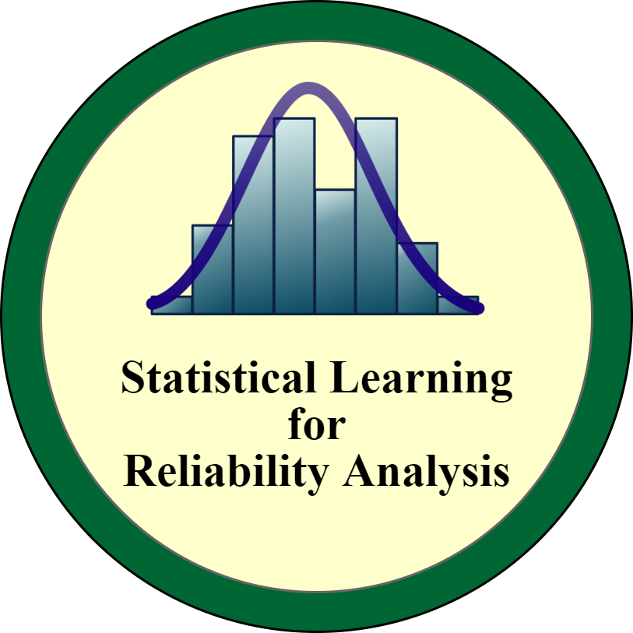
Parametric Tests : Assumptions
Usually assume certain properties of the population from which we draw samples.
Observation come from a normal population
Sample size is small
Population parameters like mean, variance, etc. hold good.
Requires measurement dealing with interval scaled data.

Slide 7
Hypothesis Testing: Non-Parametric Test
Non-parametric tests
Does not come under any assumption.
Assumes nominal, ordinal as well as interval scale data.
Note:
Non-parametric tests need entire population (or sample of very large size)

Slide 8
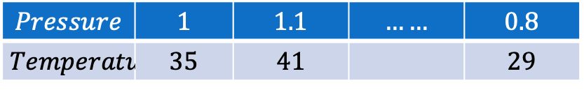
Data for Relationship Analysis
Univariate population: The population consisting of only one variable.
Example:
$$Temperature$$ | $$20$$ | $$30$$ | $$21$$ | $$18$$ | $$23$$ | $$45$$ | $$52$$
Here, statistical measures suffice to find a relationship.
Bivariate population: Here, the data happen to be with two variables.
.
Example:
$$Pressure$$ | $$1$$ | $$1.1$$ | $$……$$ | $$0.8$$
$$Temperature$$ | $$35$$ | $$41$$ |  | $$29$$

Slide 9
Data for Relationship Analysis
Multivariate population: If the data happen to be one more than two variable.
.
Example:
? If we add another variable say viscosity in addition to Pressure, Volume or Temperature?

Slide 10
Measures of Relationship
In case of bivariate and multivariate populations, usually, we have to answer two types of questions:
Q1: Does there exist relation between two variables (in case of bivariate population) ?
If yes, of what degree?
Q2: Is there any relationship between one variable in one side and two or more variables on the other side (in case of multivariate population)?
If yes, of what degree and in which direction?

Slide 11
Measures of Relationship
In case of bivariate and multivariate populations, usually, we have to answer two types of questions:
Q1: Does there exist relation between two variables (in case of bivariate population) ?
Q2: Is there any relationship between one variable in one side and two or more variables on the other side (in case of multivariate population)?
Solution
?

Slide 12
Measures of Relationship
In case of bivariate and multivariate populations, usually, we have to answer two types of questions:
Q1: Does there exist relation between two variables (in case of bivariate population) ?
Q2: Is there any relationship between one variable in one side and two or more variables on the other side (in case of multivariate population)?
To find solutions to the above questions, two approaches are known.
Correlation Analysis
Regression Analysis

Slide 13
Correlation Analyses

Slide 14
Correlation Analysis
In statistics, the word correlation is used to denote some form of association between two variables.
Example: Weight is correlated with height

Slide 15

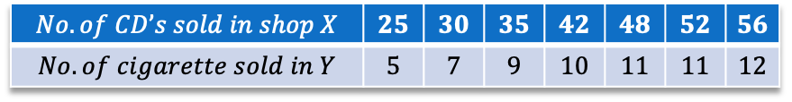
Correlation Analysis
Do you find any correlation between X and Y as shown in the table?
Look at the table given below
$$No. of CD’s sold in shop X$$ | $$25$$ | $$30$$ | $$35$$ | $$42$$ | $$48$$ | $$52$$ | $$56$$
$$No. of cigarette sold in Y$$ | $$5$$ | $$7$$ | $$9$$ | $$10$$ | $$11$$ | $$11$$ | $$12$$
Note
In statistical learning, a correlation analysis makes sense only when a relationship makes sense.

Slide 16
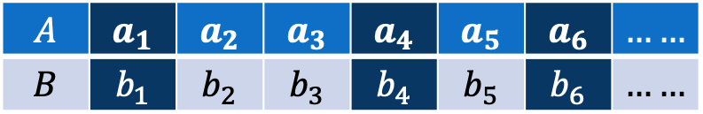
Correlation Analysis
$$A$$ | $$a_{1}$$ | $$a_{2}$$ | $$a_{3}$$ | $$a_{4}$$ | $$a_{5}$$ | $$a_{6}$$ | $$……$$
$$B$$ | $$b_{1}$$ | $$b_{2}$$ | $$b_{3}$$ | $$b_{4}$$ | $$b_{5}$$ | $$b_{6}$$ | $$……$$
Correlation
Positive correlation
Negative correlation
Zero correlation
If the value of the attribute A increases with the increase in the value of the attribute B and vice-versa.
If the value of the attribute A decreases with the increase in the value of the attribute B and vice-versa.
When the values of attribute A varies at random with B and vice-versa.

Slide 17
Correlation Analysis
Positive correlation
Negative correlation
Zero correlation

Slide 18
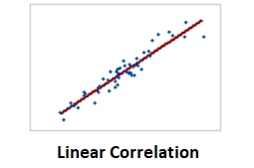
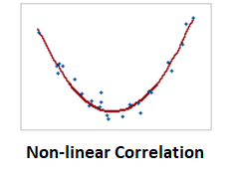
Form of Correlation
Concerning the form of a correlation, it could be linear, non-linear, or monotonic.
Linear Correlation
A correlation is linear when two variables
change at constant rate.
Non-linear Correlation
In this case, the relationship between
the variables graph as a curved pattern
parabola, hyperbola … etc).

Slide 19
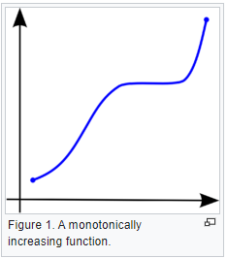
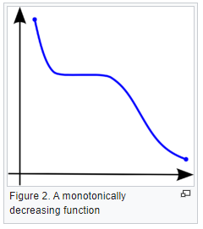
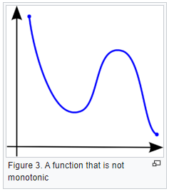
Form of Correlation
Concerning the form of a correlation , it could be linear, non-linear, or monotonic.
Monotonicity of a function

Slide 20
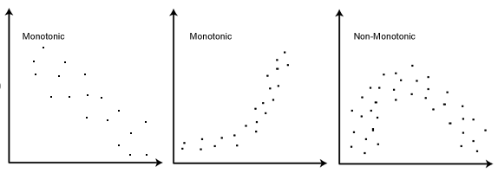
Form of Correlation
Concerning the form of a correlation , it could be linear, non-linear, or monotonic :
Monotonic and non-monotonic relations
Monotonic correlation: In a monotonic relationship, the variables tend to move in the same relative direction or opposite direction, but not necessarily at a constant rate.

Slide 21
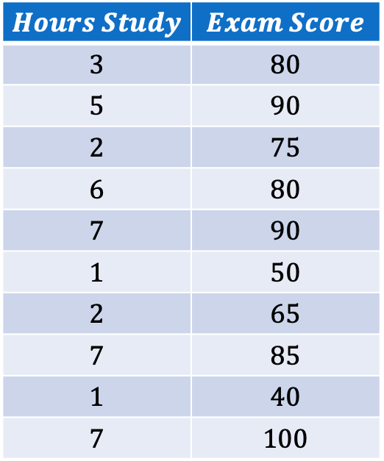
Correlation Analysis
We need to measure the degree of correlation between two attributes.
$$Hours Study$$ | $$Exam Score$$
$$3$$ | $$80$$
$$5$$ | $$90$$
$$2$$ | $$75$$
$$6$$ | $$80$$
$$7$$ | $$90$$
$$1$$ | $$50$$
$$2$$ | $$65$$
$$7$$ | $$85$$
$$1$$ | $$40$$
$$7$$ | $$100$$
Exam score

Slide 22
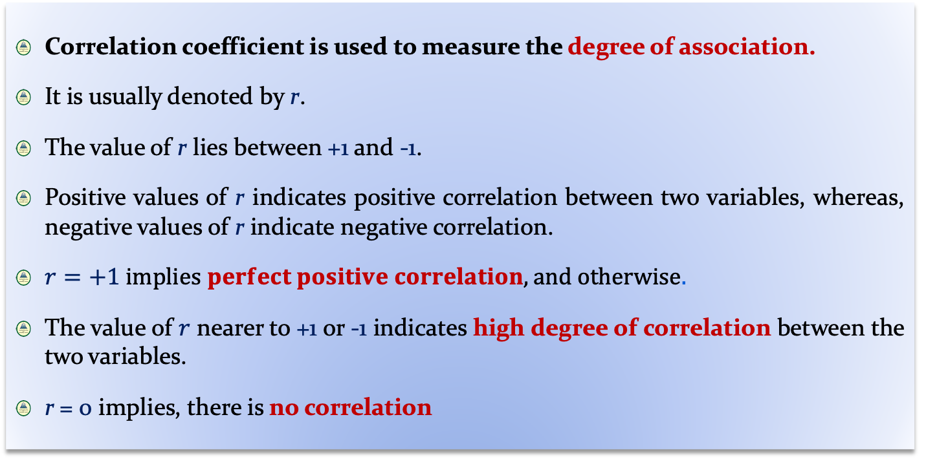
Correlation Coefficient
Correlation coefficient is used to measure the degree of association.
It is usually denoted by r.
The value of r lies between +1 and -1.
Positive values of r indicates positive correlation between two variables, whereas, negative values of r indicate negative correlation.
$r=+1 implies perfect positive correlation, and otherwise.$
The value of $r$ nearer to +1 or -1 indicates high degree of correlation between the two variables.
r = 0 implies, there is no correlation

Slide 23
Correlation Coefficient

Slide 24
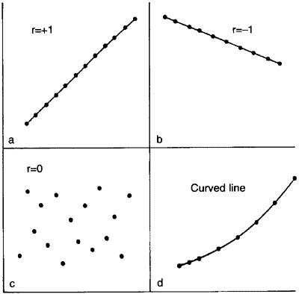
Correlation Coefficient

Slide 25
Correlation Coefficient

Slide 26
Measuring Correlation Coefficients
Three methods to measure the correlation coefficients
Karl Pearson’s coefficient
Charles Spearman’s coefficient
Chi-square coefficient of correlation
Find correlation coefficient between two numerical attributes
Find correlation coefficient between two ordinal attributes
Find correlation coefficient between two nominal attributes

Slide 27
Pearson’s Correlation Analysis

Slide 28

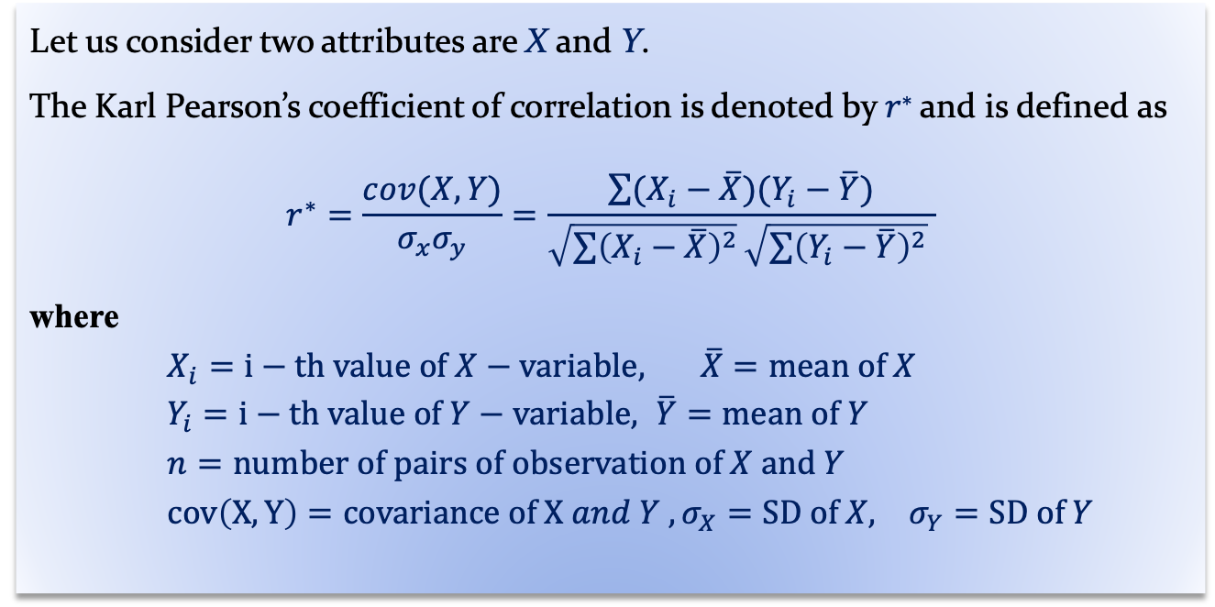
Karl Pearson’s Correlation Analysis
This is also called Pearson’s Product Moment Correlation
Definition : Karl Pearson’s correlation coefficient
Let us consider two attributes are X and Y.
The Karl Pearson’s coefficient of correlation is denoted by 𝑟∗ and is defined as
$$r^{∗}=\frac{cov(X,Y)}{σ_{x}σ_{y}}=\frac{\sum{(X_{i}−\overline{X})(Y_{i}−\overline{Y})}}{\sqrt{\sum{{\left(X_{i}−\overline{X}\right)}^{2}}}\sqrt{\sum{{\left(Y_{i}−\overline{Y}\right)}^{2}}} }$$
where
$X_{i}=i−th value of X−variable, \overline{X}=mean of X$
$Y_{i}=i−th value of Y−variable, \overline{Y}=mean of Y$
$n=number of pairs of observation of X and Y$
$cov\left(X,Y\right)=covariance of X and Y , σ_{X}=SD of X, σ_{Y}=SD of Y$
Monalisa Sarma
IIT KHARAGPUR

Slide 29
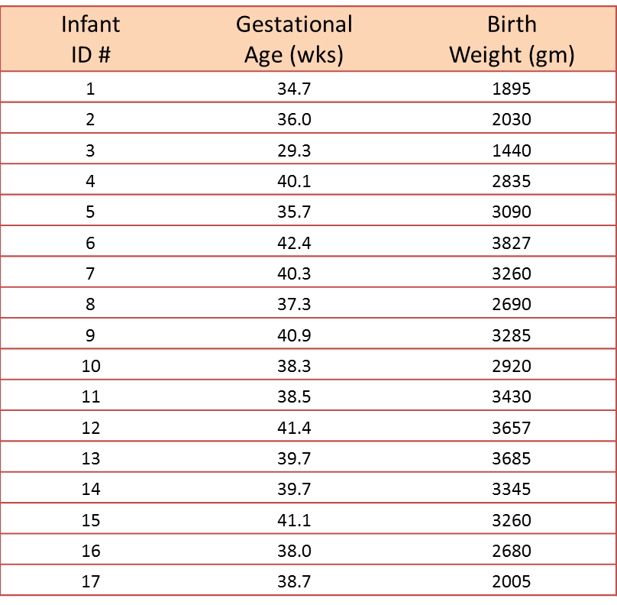
Karl Pearson’s Coefficient of Correlation
Example : Correlation of Gestational Age and Birth Weight
A small study is conducted involving 17 infants to investigate the association between gestational age at birth, measured in weeks, and birth weight, measured in grams.

Slide 30
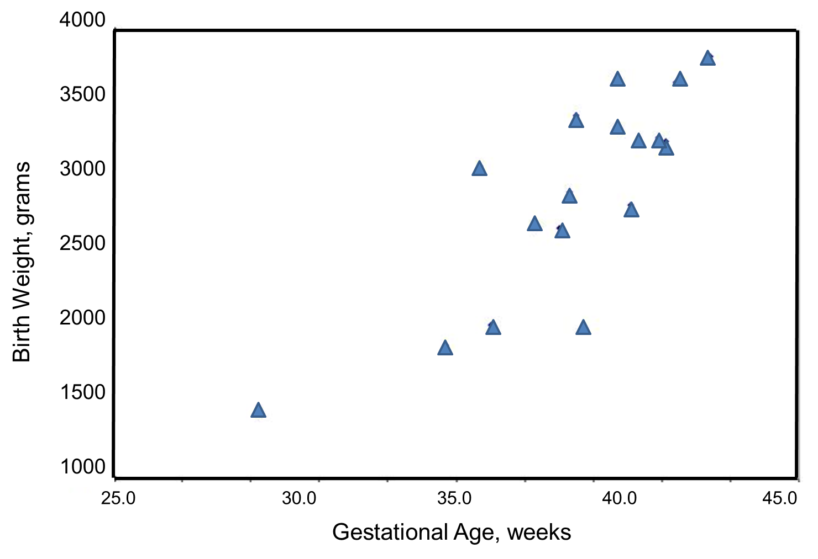
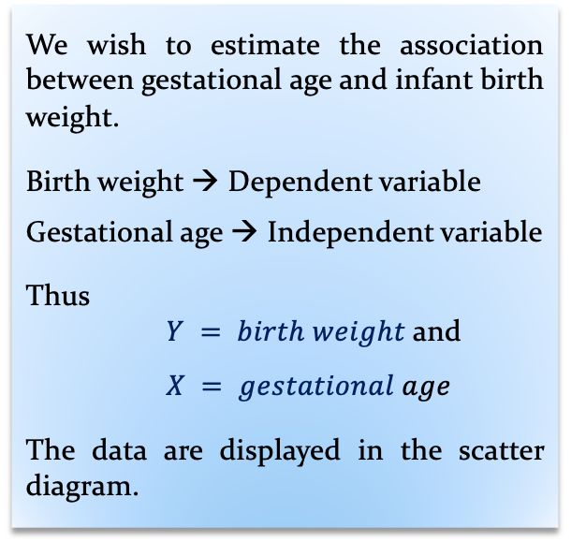
Karl Pearson’s coefficient of Correlation
Example : Correlation of Gestational Age and Birth Weight
A small study is conducted involving 17 infants to investigate the association between gestational age at birth, measured in weeks, and birth weight, measured in grams.
We wish to estimate the association between gestational age and infant birth weight.
Birth weight → Dependent variable
Gestational age → Independent variable
Thus
$Y = birth weight$ and
$X = gestational age$
The data are displayed in the scatter diagram.

Slide 31
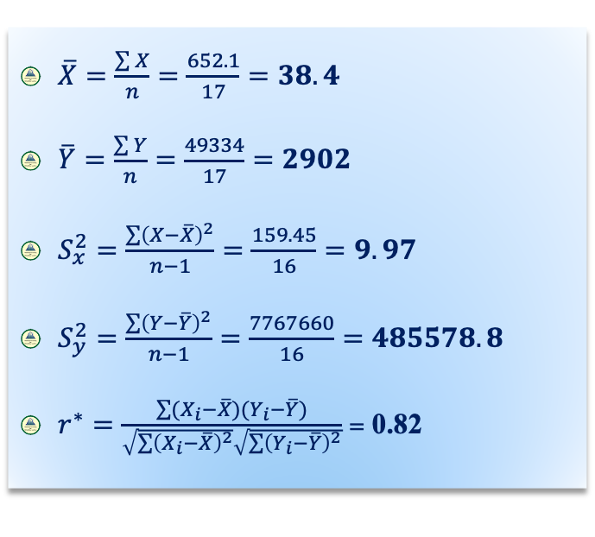
Karl Pearson’s coefficient of Correlation
For the given data
$\overline{X}=\frac{\sum{X}}{n}=\frac{652.1}{17}=38.4$
$\overline{Y}=\frac{\sum{Y}}{n}=\frac{49334}{17}=2902$
$S_{x}^{2}=\frac{\sum{{\left(X−\overline{X}\right)}^{2}}}{n−1}=\frac{159.45}{16}=9.97$
$S_{y}^{2}=\frac{\sum{{\left(Y−\overline{Y}\right)}^{2}}}{n−1}=\frac{7767660}{16}=485578.8$
$r^{∗}=\frac{\sum{(X_{i}−\overline{X})(Y_{i}−\overline{Y})}}{\sqrt{\sum{{\left(X_{i}−\overline{X}\right)}^{2}}}\sqrt{\sum{{\left(Y_{i}−\overline{Y}\right)}^{2}}}}$ = 0.82
Conclusion: The sample’s correlation coefficient indicates a strong positive correlation between Gestational Age and Birth Weight.

Slide 32
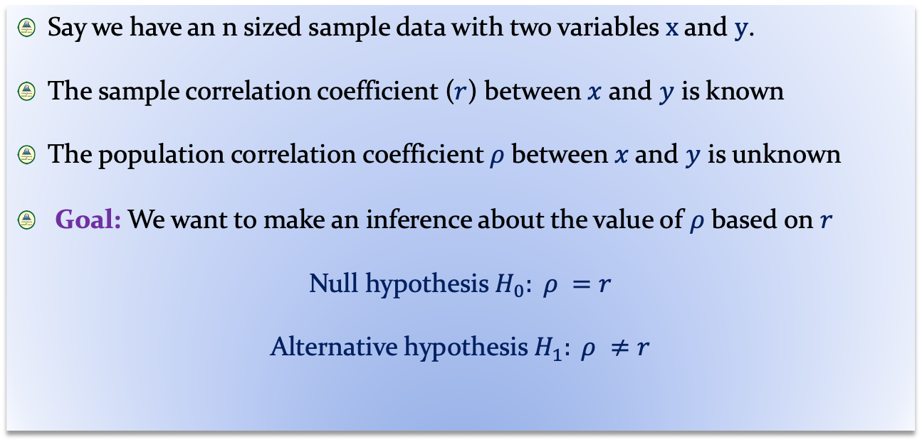
Significance Test
Definition : Karl Pearson’s correlation coefficient
Say we have an n sized sample data with two variables $x$ and $y$.
The sample correlation coefficient ($r$) between $x$ and $y$ is known
The population correlation coefficient$ρ$between$x$and $y$ is unknown
Goal: We want to make an inference about the value of $ρ$ based on $r$
Null hypothesis $H_{0}: ρ =r$
Alternative hypothesis $H_{1}: ρ ≠r$

Slide 33
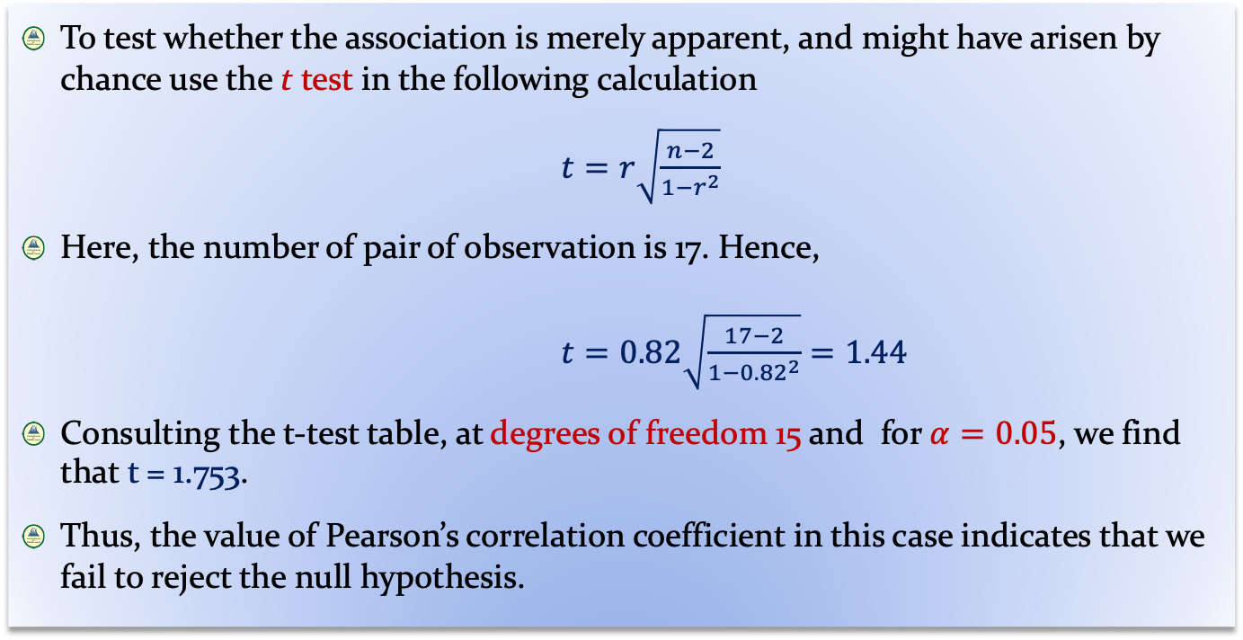
Karl Pearson’s Coefficient of Correlation
Significance Test
To test whether the association is merely apparent, and might have arisen by chance use the t test in the following calculation
$t=r\sqrt{\frac{n−2}{1−r^{2}}}$
Here, the number of pair of observation is 17. Hence,
$t=0.82\sqrt{\frac{17−2}{1−{0.82}^{2}}}=1.44$
Consulting the t-test table, at degrees of freedom 15 and for $α=0.05$, we find that t = 1.753.
Thus, the value of Pearson’s correlation coefficient in this case indicates that we fail to reject the null hypothesis.

Slide 34
Rank Correlation Analysis

Slide 35
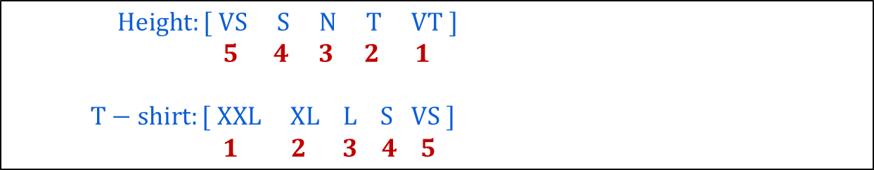
Charles Spearman’s Correlation Coefficient
This correlation measurement is also called Rank correlation
This technique is applicable to determine the degree of correlation between two variables in case of ordinal data.
We can assign rank to the different values of a variable with ordinal data type.
Example
Rank assigned

Slide 36
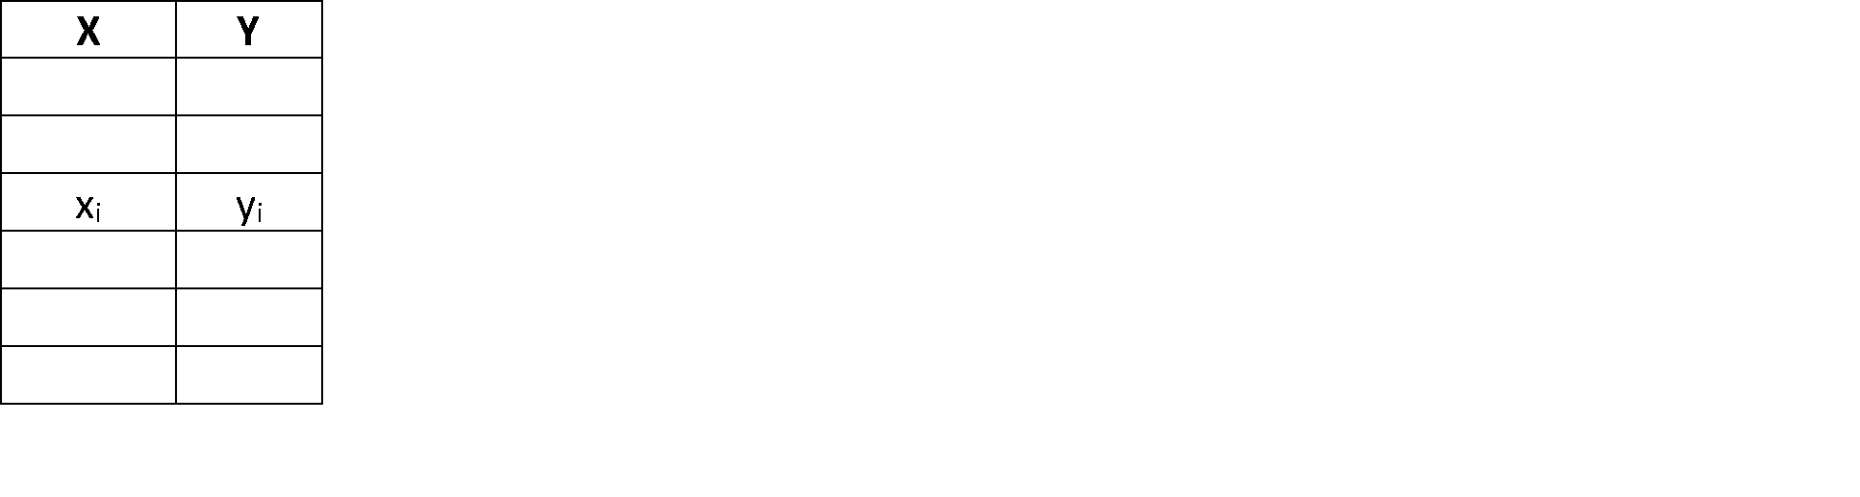
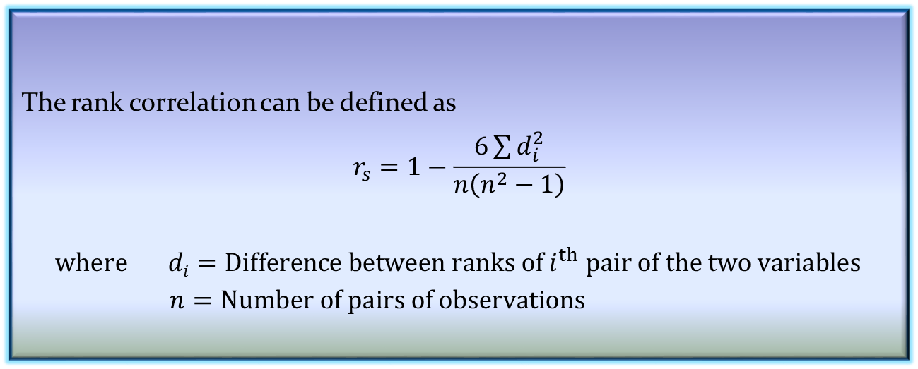
Charles Spearman’s Correlation Coefficient
The Spearman’s coefficient is often used as a statistical methods to aid either providing or disproving a hypothesis.
The rank correlation can be defined as
$$r_{s}=1−\frac{6\sum{d_{i}^{2}}}{n\left(n^{2}−1\right)}$$
$$where di=Difference between ranks of i^{th} pair of the two variables$$
$n=Number of pairs of observations$
Definition 2: Charles Spearman’s correlation coefficient

Slide 37
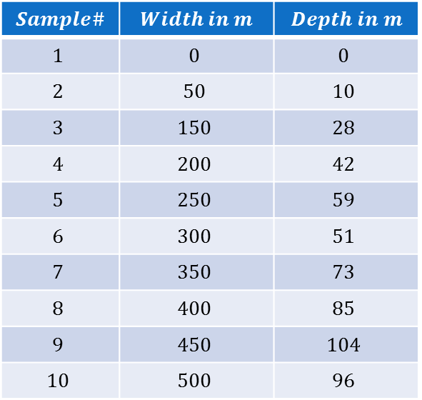
Charles Spearman’s Coefficient of Correlation
Example 2: The hypothesis that the depth of a river does not progressively increase further from the bank.
A sample of size 10 is collected to test the hypothesis, using Spearman’s correlation coefficient.
$$Sample\#$$ | $$Width in m$$ | $$Depth in m$$
$$1$$ | $$0$$ | $$0$$
$$2$$ | $$50$$ | $$10$$
$$3$$ | $$150$$ | $$28$$
$$4$$ | $$200$$ | $$42$$
$$5$$ | $$250$$ | $$59$$
$$6$$ | $$300$$ | $$51$$
$$7$$ | $$350$$ | $$73$$
$$8$$ | $$400$$ | $$85$$
$$9$$ | $$450$$ | $$104$$
$$10$$ | $$500$$ | $$96$$

Slide 38
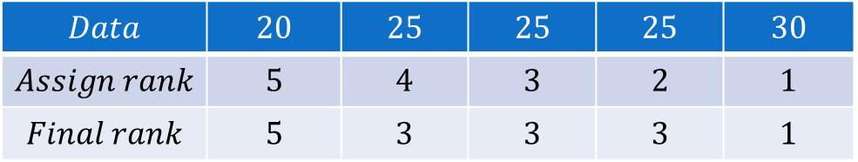
Charles Spearman’s Coefficient of Correlation
Step 1: Assign rank to each data. It is customary to assign rank 1 to the largest data, and 2 to next largest and so on.
Note: If there are two or more samples with the same value, the mean rank should be used.
$$Data$$ | $$20$$ | $$25$$ | $$25$$ | $$25$$ | $$30$$
$$Assign rank$$ | $$5$$ | $$4$$ | $$3$$ | $$2$$ | $$1$$
$$Final rank$$ | $$5$$ | $$3$$ | $$3$$ | $$3$$ | $$1$$

Slide 39
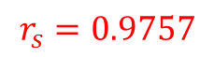
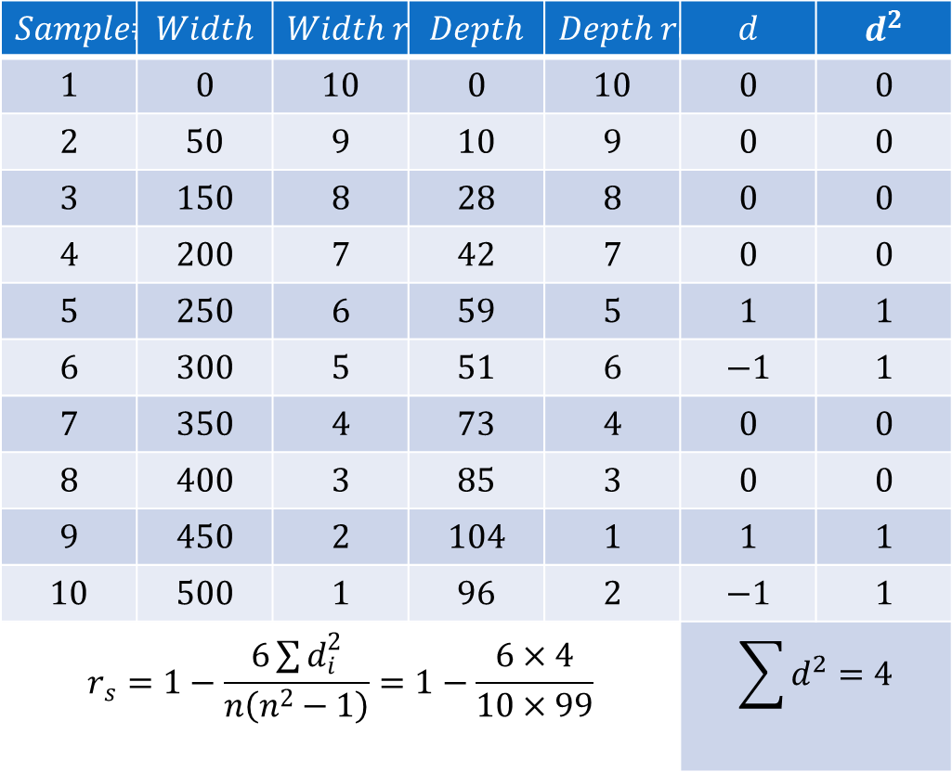
Charles Spearman’s Coefficient of Correlation
Step 2: The contingency table will look like
$$Sample\#$$ | $$Width$$ | $$Width rank$$ | $$Depth$$ | $$Depth rank$$ | $$d$$ | $$d^{2}$$
$$1$$ | $$0$$ | $$10$$ | $$0$$ | $$10$$ | $$0$$ | $$0$$
$$2$$ | $$50$$ | $$9$$ | $$10$$ | $$9$$ | $$0$$ | $$0$$
$$3$$ | $$150$$ | $$8$$ | $$28$$ | $$8$$ | $$0$$ | $$0$$
$$4$$ | $$200$$ | $$7$$ | $$42$$ | $$7$$ | $$0$$ | $$0$$
$$5$$ | $$250$$ | $$6$$ | $$59$$ | $$5$$ | $$1$$ | $$1$$
$$6$$ | $$300$$ | $$5$$ | $$51$$ | $$6$$ | $$−1$$ | $$1$$
$$7$$ | $$350$$ | $$4$$ | $$73$$ | $$4$$ | $$0$$ | $$0$$
$$8$$ | $$400$$ | $$3$$ | $$85$$ | $$3$$ | $$0$$ | $$0$$
$$9$$ | $$450$$ | $$2$$ | $$104$$ | $$1$$ | $$1$$ | $$1$$
$$10$$ | $$500$$ | $$1$$ | $$96$$ | $$2$$ | $$−1$$ | $$1$$
$$r_{s}=1−\frac{6\sum{d_{i}^{2}}}{n\left(n^{2}−1\right)}=1−\frac{6×4}{10×99}$$ |  |  |  |  | $$\sum{d^{2}=4}$$
$$r_{s}=0.9757$$

Slide 40
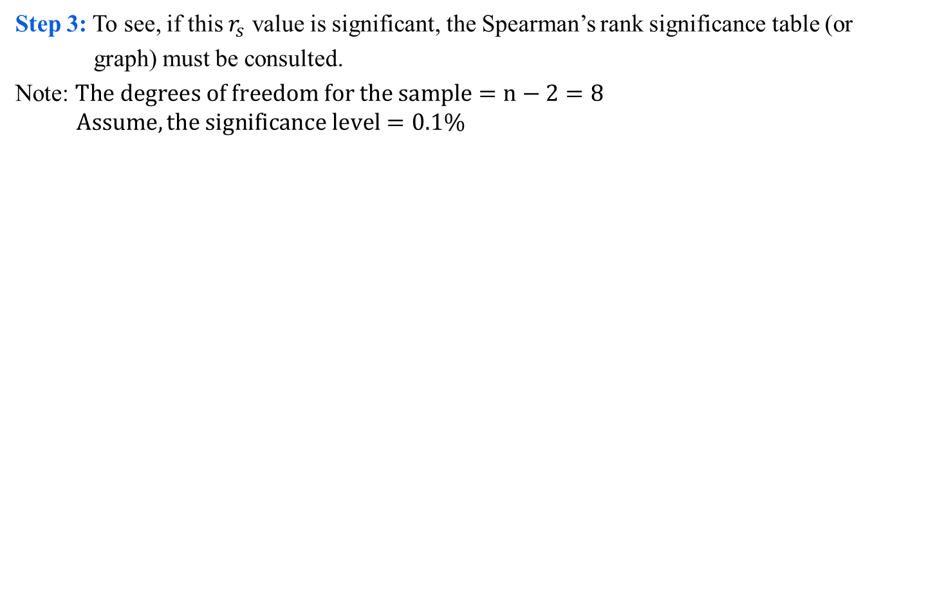
Charles Spearman’s Coefficient of Correlation
Step 3: To see, if this $r_{s}$ value is significant, the Spearman’s rank significance table (or
graph) must be consulted.
Note: $The degrees of freedom for the sample=n−2=8$
$$Assume, the significance level=0.1\%$$
Spearaman’s rank correlation coefficient

Slide 41
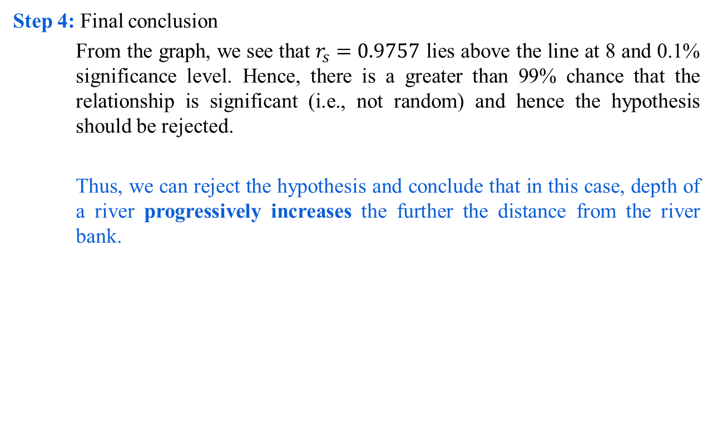
Charles Spearman’s Coefficient of Correlation
Step 4: Final conclusion
From the graph, we see that $r_{s}=0.9757$ lies above the line at 8 and 0.1% significance level. Hence, there is a greater than 99% chance that the relationship is significant (i.e., not random) and hence the hypothesis should be rejected.
Thus, we can reject the hypothesis and conclude that in this case, depth of a river progressively increases the further the distance from the river bank.

Slide 42
χ² Correlation Analysis

Slide 43
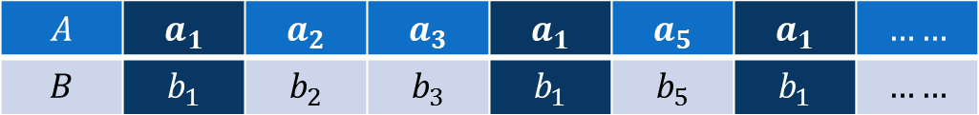
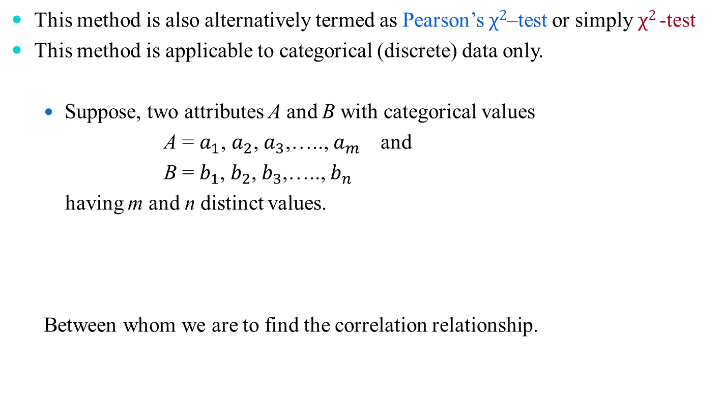
Chi-Squared Test of Correlation
This method is also alternatively termed as Pearson’s $χ2$–test or simply $χ2$-test
This method is applicable to categorical (discrete) data only.
Suppose, two attributes A and B with categorical values
A = $a_{1}$, $a_{2}$, $a_{3}$,….., $a_{m }$ and
B = $b_{1}$, $b_{2}$, $b_{3}$,….., $b_{n }$
having m and n distinct values.
Between whom we are to find the correlation relationship.
$$A$$ | $$a_{1}$$ | $$a_{2}$$ | $$a_{3}$$ | $$a_{1}$$ | $$a_{5}$$ | $$a_{1}$$ | $$……$$
$$B$$ | $$b_{1}$$ | $$b_{2}$$ | $$b_{3}$$ | $$b_{1}$$ | $$b_{5}$$ | $$b_{1}$$ | $$……$$

Slide 44
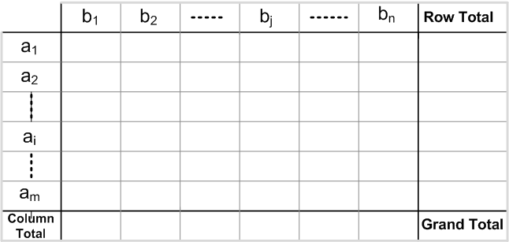
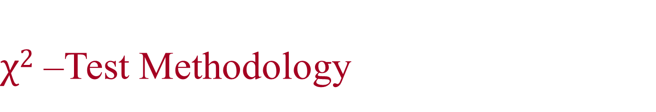
$χ2$ –Test Methodology
Contingency Table
Given a data set, it is customary to draw a contingency table, whose structure is given below.

Slide 45
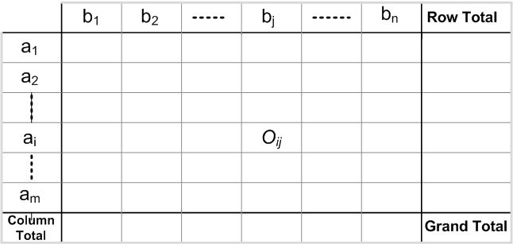
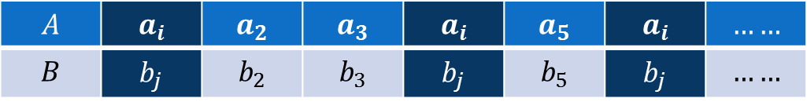
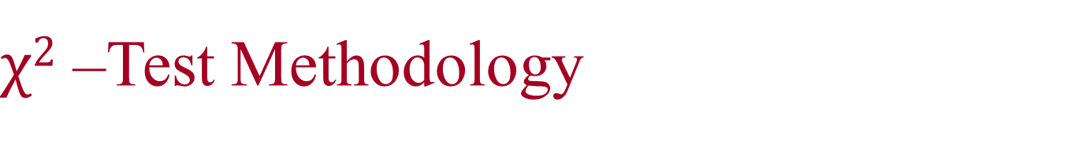
$χ2$ –Test Methodology
Entry into Contingency Table: Observed Frequency
In contingency table, an entry O_{ij} denotes the event that attribute A takes on value a_{i} and attribute B takes on value b_{j} (i.e., A = a_{i}, B = b_{j}).
$$A$$ | $$a_{i}$$ | $$a_{2}$$ | $$a_{3}$$ | $$a_{i}$$ | $$a_{5}$$ | $$a_{i}$$ | $$……$$
$$B$$ | $$b_{j}$$ | $$b_{2}$$ | $$b_{3}$$ | $$b_{j}$$ | $$b_{5}$$ | $$b_{j}$$ | $$……$$
A | B
… | …
ai | bj
… | …
ai | bj
… | …
… | …
ai | bj
… | …
… | …
… | …
… | …

Slide 46
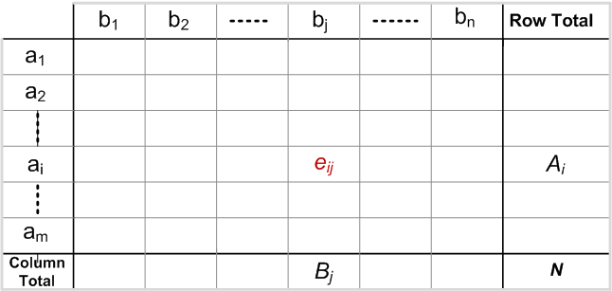

$χ2$ –Test Methodology
Entry into Contingency Table: Expected Frequency
In contingency table, an entry e_{ij} denotes the expected frequency, which can be calculated as
$$e_{ij}=\frac{Count(A=a_{i})×Count(B=b_{j})}{Grand Total}=\frac{A_{i}×B_{j}}{N}$$
A | B
… | …
ai | bj
… | …
ai | bj
… | …
… | …
ai | bj
… | …
… | …
… | …
… | …

Slide 47
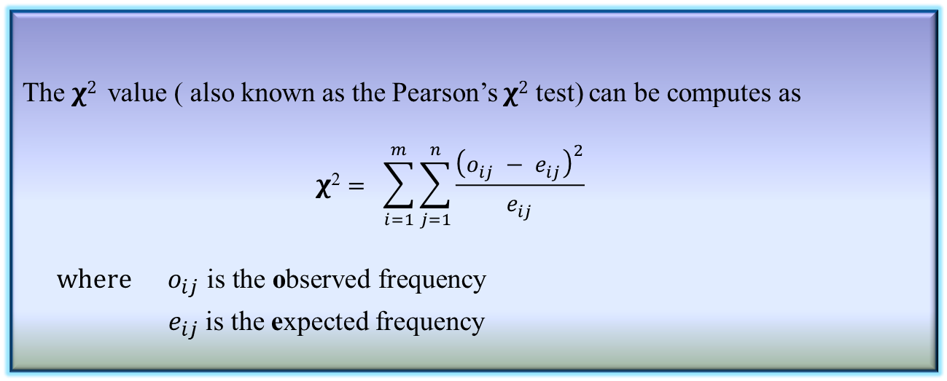
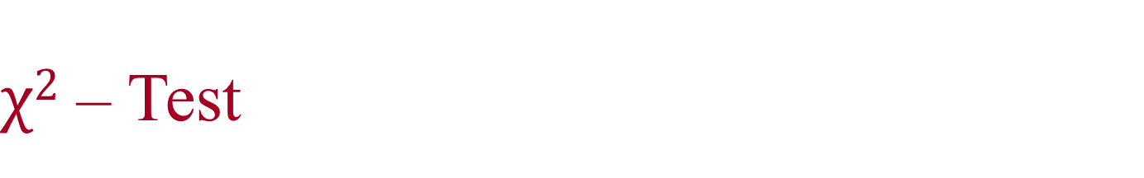
$χ2$ – Test
The $χ2$ value ( also known as the Pearson’s $χ2$ test) can be computes as
$$\text{χ}\text{2}= \sum_{i=1}^{m}{\sum_{j=1}^{n}{\frac{{\left(o_{ij} − e_{ij}\right)}^{2}}{e_{ij}}}}$$
$$where{ o}_{ij} \text{is} \text{the} \text{o}\text{bserved} \text{frequency}$$
${ e}_{ij}$ is the expected frequency
Definition 3: χ²-Value

Slide 48
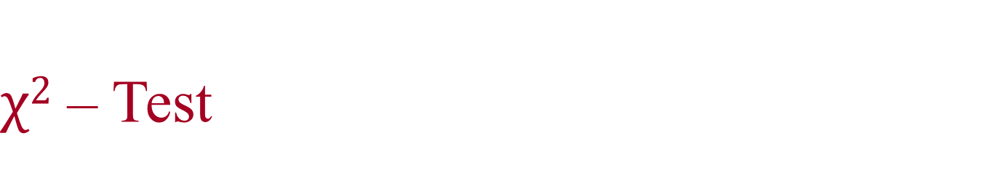
$χ2$ – Test
The cell that contribute the most to the 𝛘² value are those whose actual count is very different from the expected.
The 𝛘² statistics tests the hypothesis that A and B are independent. The test is based on a significance level, with (n-1) ×(m-1) degrees of freedom., with a contingency table of size n×m
If the hypothesis can be rejected, then we say that A and B are statistically related or associated.

Slide 49
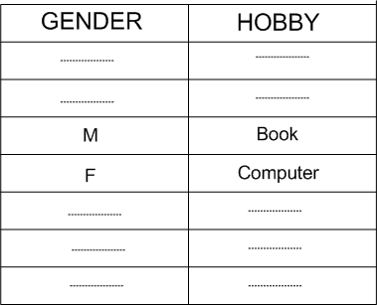
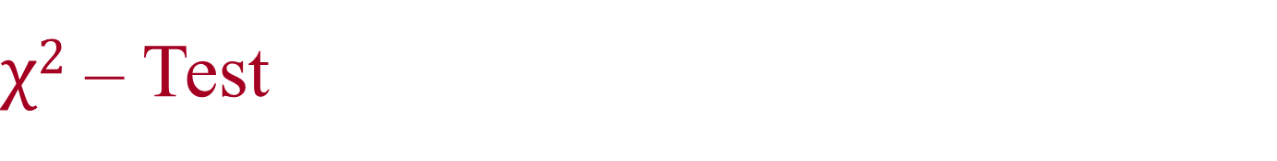
$χ2$ – Test
Example 3: Survey on Gender versus Hobby.
Suppose, a survey was conducted among a population of size 1500. In this survey, gender of each person and their hobby as either “book” or “computer” was noted. The survey result obtained in a table like the following.
We have to find if there is any association between Gender and Hobby of a people, that is, we are to test whether “gender” and “hobby” are correlated.

Slide 50
χ² –Test
Example : Survey on Gender versus Hobby.
From the survey table, the observed frequency are counted and entered into the contingency table, which is shown below.
HOBBY | GENDER
 |  | Male | Female | Total
 | Book
 | Computer
 | Total

Slide 51
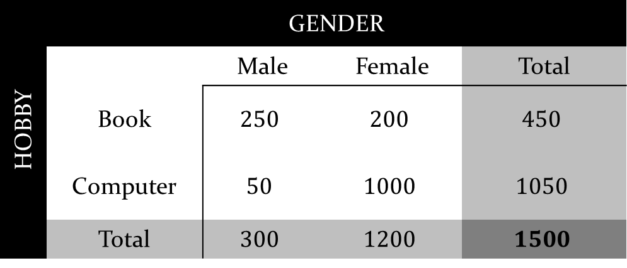
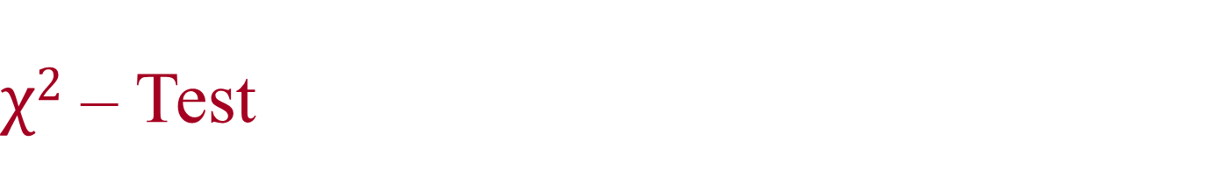
$χ2$ – Test
Example 7.3: Survey on Gender versus Hobby.
From the survey table, the observed frequency are counted and entered into the contingency table, which is shown below.
HOBBY | GENDER
 |  | Male | Female | Total
 | Book | $$250$$ | $$200$$ | $$450$$
 | Computer | $$50$$ | $$1000$$ | $$1050$$
 | Total | $$300$$ | $$1200$$ | $$1500$$

Slide 52
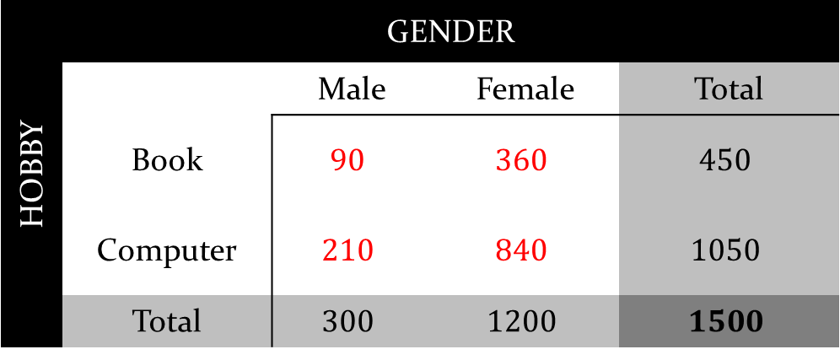
$χ2$ – Test
Example 3: Survey on Gender versus Hobby.
From the survey table, the expected frequency are counted and entered into the contingency table, which is shown below.
HOBBY | GENDER
 |  | Male | Female | Total
 | Book | $$90$$ | $$360$$ | $$450$$
 | Computer | $$210$$ | $$840$$ | $$1050$$
 | Total | $$300$$ | $$1200$$ | $$1500$$

Slide 53
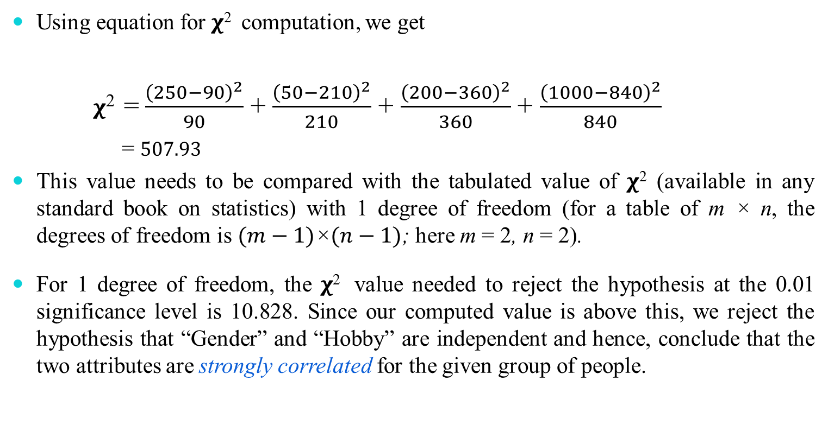

$χ2$ – Test
Using equation for 𝛘² computation, we get
𝛘² =$\frac{{\left(250−90\right)}^{2}}{90}$ + $\frac{{\left(50−210\right)}^{2}}{210}$ + $\frac{{\left(200−360\right)}^{2}}{360}$ + $\frac{{\left(1000−840\right)}^{2}}{840}$
= $507.93$
This value needs to be compared with the tabulated value of 𝛘² (available in any standard book on statistics) with 1 degree of freedom (for a table of m × n, the degrees of freedom is $(m−1)\text{×}(n−1)$; here m = 2, n = 2).
For 1 degree of freedom, the 𝛘² value needed to reject the hypothesis at the 0.01 significance level is 10.828. Since our computed value is above this, we reject the hypothesis that “Gender” and “Hobby” are independent and hence, conclude that the two attributes are strongly correlated for the given group of people.

Slide 54
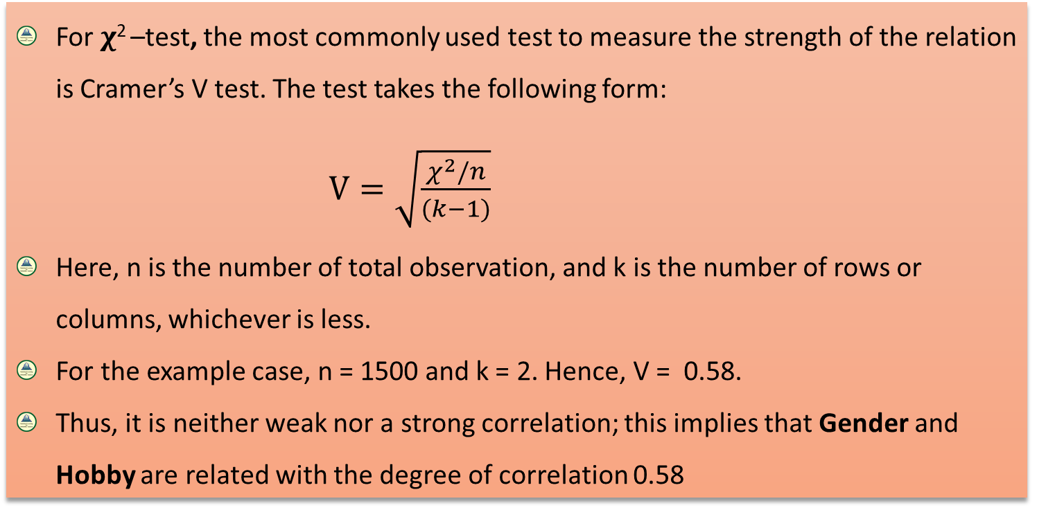
Significance Test for 𝛘² -Test
Cramer’s V Test

Slide 55
More on Correlation Analyses

Slide 56
Binary variable to binary variable correlation
Tetrachoric correlation
Nominal/ categorical valued variable to binary variable correlation
Cramer’s V correlation
Continuous variable to binary variable correlation
Point-biserial correlation

Slide 57
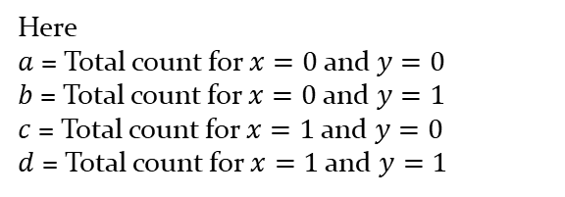
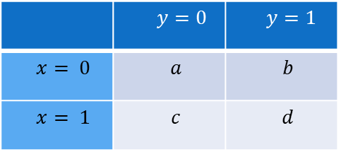
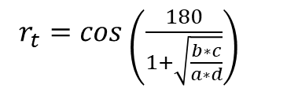
Tetrachoric correlation
Tetrachoric correlation is a measure of the association between two binary variables, that is, variables that can only take on two values like “yes” and “no” or “good” and “bad.”
Suppose, we have the following 2×2 table with two variables, x and y, that both take on two values:
Here
$a$ = Total count for $x=0$and $y=0$
$b$ = Total count for $x=0$ and $y=1$
$c$ = Total count for $x=1$ and $y=0$
$d$ = Total count for $x=1$ and $y=1$
 | $y=0$ | $y=1$
$$x= 0$$ | $$a$$ | $$b$$
$$x= 1$$ | $$c$$ | $$d$$
$r_{t}=cos\left(\frac{180}{1+\sqrt{\frac{b∗c}{a∗d}}}\right)$

Slide 58


Tetrachoric correlation: Example
Example:
Suppose, we want to know whether or not gender is associated with political party preference so we take a simple random sample of 47 voters and survey them on their political party preference.
 | $$y= party 1$$ | $$y=party 2$$
$$x=male$$ | $$9$$ | $$15$$
$$x=female$$ | $$13$$ | $$10$$
Here
$a$ = 9 for $x=male$and $y=party 1$
$b$ = 15 for$x=male$and $y=party 2$
$c$ = 13 for$x=female$and $y=party 1$
$d$ = 10 for$x=female$and $y=party 2$

Slide 59



Tetrachoric correlation: Example
$r_{t}=cos\left(\frac{180}{1+\sqrt{\frac{b∗c}{a∗d}}}\right)$
 | $$y= party 1$$ | $$y=party 2$$
$$x=male$$ | $$9$$ | $$15$$
$$x=female$$ | $$13$$ | $$10$$
Here
$a$ = 9 for $x=male$and $y=party 1$
$b$ = 15 for$x=male$and $y=party 2$
$c$ = 13 for$x=female$and $y=party 1$
$d$ = 10 for$x=female$and $y=party 2$
$r_{t}=cos\left(\frac{180}{1+\sqrt{\frac{b∗c}{a∗d}}}\right)$
$=cos\left(\frac{180}{1+\sqrt{\frac{15∗13}{9∗10}}}\right)$
$=cos\left(\frac{180}{1+1.471}\right)$
$=cos\left(\frac{180}{2.471}\right)$ $=cos$(72.84) = 0.29
Here, the coefficient of correlation between gender and political party preference is 0.29.
This correlation is significantly low, which indicates that there is a weak correlation between gender and preference of political party .

Slide 60


Cramer’s V correlation
Cramer's V correlation is used to measure the strength of association between two variables with nominal or categorical values.
Each variable can have two or more than two nominal or categorical values also.
Cramer's V correlation coefficient
$r_{cv}= \sqrt{\frac{\frac{\text{χ}\text{2}}{n}}{min⁡(m−1,c−1)}}$
χ2 = The Chi-square statistics
$n$ = Total number of samples in the dataset
$m$ = Number of classes of dependent variable
$c$= Number of columns in the dataset

Slide 61

Cramer’s V correlation: Example
Example:
Suppose, we want to know if there is any association between three different eye colors (blue, green and brown) and three regions (east, north and west). After surveying 50 random samples, the following data is obtained.
 | Eye Color
 | Blue | Green | Brown
East | $$8$$ | $$5$$ | $$6$$
North | $$2$$ | $$8$$ | $$3$$
west | $$4$$ | $$6$$ | $$8$$

Slide 62

Cramer’s V correlation: Example
 | Eye Color
 | Blue | Green | Brown | Row Total
East | $$8$$ | $$5$$ | $$6$$ | 19
North | $$2$$ | $$8$$ | $$3$$ | 13
west | $$4$$ | $$6$$ | $$8$$ | 18
Column Total | 14 | 19 | 17 | Grand total 50
Step 1:
Here all the frequencies are called observed frequency.
Add all values row wise and column wise.
Here
row totals are 19,13,18
column totals are 14, 19, 17
Grand Total is 50

Slide 63


Cramer’s V correlation: Example
 | Eye Color
 | Blue | Green | Brown | Row Total
East | $\frac{19∗14}{50}$ = 5.32 | $$\frac{19∗19}{50}\text{ = }\text{7.22}$$ | $\frac{19∗17}{50}\text{ = 6}$.46 | 19
North | $$\frac{13∗14}{50}\text{ = }\text{3.64}$$ | $\frac{13∗19}{50}\text{ = 4}$.94 | $$\frac{13∗17}{50}\text{ = }\text{4.42}$$ | 13
west | $$\frac{18∗14}{50}\text{ = }\text{5.04}$$ | $$\frac{18∗19}{50}\text{ = 6.84}$$ | $\frac{18∗17}{50}\text{ = 6}$.12 | 18
Column Total | 14 | $$19$$ | 17 | Grand Total = 50
Step 2:
Calculate expected frequencies for each cell.
Expected frequency
$e_{ij}$ = $\frac{\text{(}i^{th} \text{row} \text{total}\text{)∗(}j^{th }\text{column} \text{total}\text{)}}{Grand total}$
$$\text{χ}\text{2}= \sum_{i=1}^{m}{\sum_{j=1}^{n}{\frac{{\left(o_{ij} − e_{ij}\right)}^{2}}{e_{ij}}}}$$
$$o_{ij} \text{is} \text{the} \text{o}\text{bserved} \text{frequency}$$
${ e}_{ij}$ is the expected frequency

Slide 64



Cramer’s V correlation: Example
Step 3:
Calculate $\text{χ}\text{2}= \sum_{i=1}^{m}{\sum_{j=1}^{n}{\frac{{\left(o_{ij} − e_{ij}\right)}^{2}}{e_{ij}}}}$
Observed values | Eye Color
 | Blue | Green | Brown
East | $$8$$ | $$5$$ | $$6$$
North | $$2$$ | $$8$$ | $$3$$
west | $$4$$ | $$6$$ | $$8$$
Expected values | Eye Color
 | Blue | Green | Brown
East | 5.32 | $$\text{7.22}$$ | $$\text{6.46}$$
North | $\text{3.}$64 | $\text{4}$.94 | $\text{4}$.42
west | $$\text{5.04}$$ | $\text{6}$.84 | $$\text{6.12}$$
$\text{χ}\text{2}$ = $\frac{{(8−5.32)}^{2}}{5.32}+\frac{{(5−7.22)}^{2}}{7.22}+\frac{{(6−6.46)}^{2}}{6.46}+\frac{{(2−3.64)}^{2}}{3.64}+\frac{{(8−4.94)}^{2}}{4.94}+\frac{{(3−4.42)}^{2}}{4.42}+\frac{{(4−5.04)}^{2}}{5.04}+\frac{{(6−6.84)}^{2}}{6.84}+\frac{{(8−6.12)}^{2}}{6.12}=6.35$

Slide 65


Cramer’s V correlation: Example
Step 4:
Putting the below given values to the equation
$\text{χ}\text{2 }$= $6.35$
$$n =50$$
$$m = 3$$
$$c= 3$$
$r_{cv}= \sqrt{\frac{\frac{\text{χ}\text{2}}{n}}{min⁡(m−1,c−1)}}$ = $\sqrt{\frac{\frac{6.35 }{50}}{min⁡(3−1,3−1)}}=\sqrt{\frac{\text{0.127}}{2}}=0.25$
The correlation between three different eye colors (blue, green and brown) and three regions (east, north and west) is 0.25
It means eye color is weakly associated with the regions.

Slide 66

Point-biserial correlation
Point-biserial correlation is a measure of the association between a continuous valued and a binary valued
variable.
Point-biserial correlation coefficient
$r_{pb}=\left|\frac{M_{1}−M_{0}}{S_{n}}\right|\sqrt{p∗q}$
where,
$M_{1}$= mean of values in $x_{i}$, when $y$= 1.
$M_{0}$ = mean of values in $x_{i}$ , when$y$= 0.
$S_{n}$ = standard deviation of the attribute values $x_{i}$ with a sample of size $n$.
$p$ = Proportion of cases for $y$= 0
$q$ = Proportion of cases for $y$ = 1

Slide 67


Point-biserial correlation: Example
Example:
Suppose we want to know whether or not gender is associated with weekly expenditure of the students, where we take a simple random sample of 7 students and survey on them.
$x=expanditure$ | $y=gender$
12 | 1
8 | 1
$$7$$ | $$1$$
$$22$$ | $$0$$
$$18$$ | $$0$$
$$16$$ | $$0$$
$$20$$ | $$0$$
Step 1:
Here, 1= male and 0 = female
$M_{1}$= $\frac{(12+8+7) }{3}$ $=9$
$M_{0}$= $\frac{(22+18+16+20) }{4}$ $=19$
$$n=7$$

Slide 68


Point-biserial correlation: Example
$x=expanditure$ | $y=gender$
12 | 1
8 | 1
$$7$$ | $$1$$
$$22$$ | $$0$$
$$18$$ | $$0$$
$$16$$ | $$0$$
$$20$$ | $$0$$
Step 2:
$p$= $\frac{Total number of male}{n}$ = $\frac{3}{7}=0.43$
$q$ = $\frac{Total number of female}{n}$ = $\frac{4}{7}=0.47$
Step 3:
$S_{n}= \sqrt{\frac{{{(x}_{i}−\overline{x})}^{2}}{n}}=5.85$ where, $\overline{x}=\frac{12+8+7+22+18+16+20}{7}=14.71$
So,
$r_{pb}=\left|\frac{M_{1}−M_{0}}{S_{n}}\right|\sqrt{p∗q}=\left|\frac{9−19}{14.71}\right|\sqrt{0.43∗0.47}$ $=0.85$
Here, the coefficient of correlation between gender and weekly expenditure of the students is 0.85.
It means gender is strongly associated with weekly expenditure of the students.

Slide 69
Regression Analyses

Slide 70


Learning Strategies
There are two types of learning concepts:
Learning
Learning population parameters
Statistical Learning
Learning models
Machine Learning

Slide 71
Statistical Learning
Usually assumes certain properties of the population from which we draw samples:
Observation come from a normal population.
Sample size is small.
Population parameters like mean, variance, etc. are hold good.
Requires measurement equivalent to interval scaled data.

Slide 72


Machine Learning
y = f(x) = ax² + bx + c
Does not under any assumption
Works well with high volume high dimensional data
Important Point
This learning strategy needs a very large sample data

Slide 73
Relationship Analysis

Slide 74
Relationship Analysis
Example: Wage Data
A large data regarding the wages for a group of employees from the eastern region of India is given.
In particular, we wish to understand the following relationships:
Employee’s age and wage: How wages vary with ages?
Calendar year and wage: How wages vary with time?
Employee’s age and education: Whether wages are anyway related with employees’ education levels?

Slide 75

Relationship Analysis
Example: Wage Data
Case I. Wage versus Age
From the data set, we have a graphical representations, which is as follows:
How wages vary with ages?
?
How wages vary with ages?

Slide 76

Relationship Analysis
Example: Wage Data
Employee’s age and wage: How wages vary with ages?
Interpretation: On the average, wage increases with age until about 60 years of age, at which point it begins to decline.

Slide 77

Relationship Analysis
Example: Wage Data
Case II. Wage versus Year
From the data set, we have a graphical representations, which is as follows:
?
How wages vary with time?

Slide 78

Relationship Analysis
Example: Wage Data
Wage and calendar year: How wages vary with years?
Interpretation: There is a slow but steady increase in the average wage between 2010 and 2016.
.

Slide 79

Relationship Analysis
Example: Wage Data
Case III. Wage versus Education
From the data set, we have a graphical representations, which is as follows:
?
Whether wages are related with education?

Slide 80

Relationship Analysis
Example: Wage Data
Wage and education level: Whether wages vary with employees’ education levels?
Interpretation: On the average, wage increases with the level of education.

Slide 81

Relationship Analysis
What more information can we get?
Whether wage has any association with both year and education level?
Given an employee’s wage can we predict his age?
... and what’s more?

Slide 82
Regression Analysis to Find Relationships

Slide 83
An Open Challenge!
Suppose there are countably infinite points in the $XY plane$. We need a huge memory to store all such points.
Is there any way out to store this information with a least amount of memory?
Say, with two values only.

Slide 84
Yahoo!
Just decide the values of a and b
(as if storing one point’s data only!)
Note: Here, tricks was to find a relationship among all the points.

Slide 85


Measures of Relationship
Univariate Population
$$Temperature$$ | $$20$$ | $$30$$ | $$21$$ | $$18$$ | $$23$$ | $$45$$ | $$52$$
Bivariate Population
$$Temperature$$ | $$20$$ | $$30$$ | $$21$$ | $$18$$ | $$23$$ | $$45$$ | $$52$$
Pressure | 1 | 1.5 | 1.05 | 0.96 | 1.2 | 2.5 | 2.8
Multivariate Population
$$Temperature$$ | $$20$$ | $$30$$ | $$21$$ | $$18$$ | $$23$$ | $$45$$ | $$52$$
Pressure | 1 | 1.5 | 1.05 | 0.96 | 1.2 | 2.5 | 2.8
$$Volume$$ | $$20$$ | $$30$$ | $$21$$ | $$18$$ | $$23$$ | $$45$$ | $$52$$

Slide 86
Measures of Relationship
Relationship Analysis
Regression analysis
Linear Regression
Simple Linear Regression
Multiple Linear Regression
Non-linear Regression
Simple Non-linear Regression
Multiple Non-linear Regression
Auto-Regression Analysis
Logistic regression
Binary Logistic Regression
Multinomial Logistic Regression

Slide 87
Regression Analysis
Definition
The regression analysis is a statistical method to deal with the formulation of mathematical model depicting relationship amongst variables, which can be used for the purpose of prediction of the values of dependent variable, given the values of independent variable(s).

Slide 88

A Simple Example
How Exam Score is related to Hours of Study?
$$Hours Study$$ | $$Exam Score$$
$$3$$ | $$80$$
$$5$$ | $$90$$
$$2$$ | $$75$$
$$6$$ | $$80$$
$$7$$ | $$90$$
$$1$$ | $$50$$
$$2$$ | $$65$$
$$7$$ | $$85$$
$$1$$ | $$40$$
$$7$$ | $$100$$

Slide 89

Regression Analyses
Simple Linear Regression
Linear Regression Models
Regression Analysis
Multiple Linear Regression
Non-linear Regression Models

Slide 90
Simple Linear Regression

Slide 91




Simple Linear Regression Model
In simple linear regression, we have only two variables:
Linear regression

Slide 92


Simple Linear Regression Model
In simple linear regression, we have only two variables:
Note

Slide 93



Regression Analysis

Slide 94

Regression Analysis
Note

Slide 95


True versus Fitted Regression Line

Slide 96


Least Square Method to estimate 𝛼 and 𝛽
Concept of Residuals

Slide 97

Least Square Method to estimate 𝛼 and 𝛽
Sum of Squares Error (SSE)
We need to minimize the value of SSE and hence to determine the parameters of a and b.

Slide 98


Least Square Method to estimate 𝛼 and 𝛽
Minimizing the Sum of Squares Error (SSE)

Slide 99

Least Square Method to estimate 𝛼 and 𝛽
Minimizing the Sum of Squares Error (SSE)

Slide 100


Least Square Method to estimate 𝛼 and 𝛽
Minimizing the Sum of Squares Error (SSE)

Slide 101


Slide 102



R2: Measure of Quality Fit
Coefficient of Determination

Slide 103


R2: Measure of Quality Fit
Coefficient of Determination
Note

Slide 104
Multiple Linear Regression

Slide 105
Regression Analyses
Simple Linear Regression
Linear Regression Models
Regression Analysis
Multiple Linear Regression
Non-linear Regression Models

Slide 106

Multiple Linear Regression
Definition:
Multiple Regression Model: When more than one variable are independent variable, then the regression can be estimated as a multiple regression model
Multiple Linear Regression: When this model is linear in coefficients, it is called multiple linear regression model

Slide 107

Multiple Linear Regression
Formulation:
If k-independent variables $x_{1},x_{2}$, $x_{3}$…………, $x_{k}$ are associated, the multiple linear regression model is given by
$y_{i}= β_{0}$+${ β}_{1}x_{1}+β_{2}x_{2}$+${ β}_{k}x_{k}+∈$
And the estimated response is obtained as
$ŷ_{i}= b_{0}$+$b_{1}x_{1}+b_{2}x_{2}$+${ b}_{k}x_{k}$

Slide 108

Multiple Linear Regression
Estimating the coefficients: The data points
Let the data points given to us are
($x_{1i}, x_{2i},$ $x_{3i}, ……………….,$ $x_{ki}, y_{i}$) $i=1,2,………,n, n>k$
where $y_{i}$ is the observed response to the values $x_{1i}, x_{2i},$ $x_{3i}, ……………….,$ $x_{ki}$ of $k$ independent variables $x_{1}, x_{2},$ $x_{3}, ……………….,$ $x_{k}$.

Slide 109

Multiple Linear Regression
Estimating the coefficients: The model formulation
So, the regression model in this case is given by,
$y_{i}= β_{0}$+${ β}_{1}x_{1i}+β_{2}x_{2i}$+${ β}_{k}x_{ki}+∈_{i}$
and $ŷ_{i}= b_{0}$+$b_{1}x_{1i}+b_{2}x_{2i}$+${ b}_{k}x_{ki}+e_{i}$
where $∈_{i}$ and $e_{i}$ are the random error and residual error, respectively associated with true response $y_{i}$ and fitted response${ ŷ}_{i}$.

Slide 110

Multiple Linear Regression
Estimating the coefficients: Minimization of the SSE
Using the concept of Least Square Method to estimate $b_{0},b_{1},b_{2},…,b_{k}$, we minimize the expression
$SSE=\sum_{i=1}^{n}{e_{i}^{2}}=\sum_{i=1}^{n}{{(y_{i}\text{−}ŷ_{i}\text{)}}^{2}}$
To minimize the SSE, we need to differentiate SSE in turn with respect to $b_{0},b_{1},b_{2},…,b_{k}$ and equate to zero.

Slide 111


Multiple Linear Regression
Estimating the coefficients: Minimization of the SSE
Differentiating SSE in turn with respect to $b_{0},b_{1},b_{2},…,b_{k}$ and equating to zero, we generate the set of (k+1) normal estimation equations for multiple linear regression.
${nb}_{0}$+$b_{1}\sum_{i=1}^{n}{x_{1i}}+b_{2}\sum_{i=1}^{n}{x_{2i}}$+${…+ b}_{k}\sum_{i=1}^{n}{x_{ki}}={\sum_{i=1}^{n}{y}}_{i}$
$b_{0}\sum_{i=1}^{n}{x_{1i}}+b_{1}\sum_{i=1}^{n}{x_{1i}^{2}}$+$b_{2}\sum_{i=1}^{n}{x_{1i}.x_{2i}+}{…+ b}_{k}\sum_{i=1}^{n}{{x_{1i}.x}_{ki}}={\sum_{i=1}^{n}{x_{i}.y}}_{i}$
… … … … … …
… … … … … …
$b_{0}\sum_{i=1}^{n}{x_{ki}}+b_{1}\sum_{i=1}^{n}{x_{ki}.x_{1i}}$+$b_{2}\sum_{i=1}^{n}{x_{ki}.x_{2i}+}{…+ b}_{k}\sum_{i=1}^{n}{x_{ki}^{2}}={\sum_{i=1}^{n}{x_{i}.y}}_{i}$
The system of linear equations can be solved for $b_{0},b_{1}, …,b_{k}$ by any appropriate method for solving system of linear equations.

Slide 112
Non-Linear Regression Model

Slide 113
Regression Analyses
Simple Linear Regression
Linear Regression Models
Regression Analysis
Multiple Linear Regression
Non-linear Regression Models

Slide 114

Non-linear Regression Model
Definition and Formulation:
Non-linear Regression Model: When the regression equation is in terms of $r−$degree, $r>1$, then it is called non-linear regression model
Multiple Non-linear Regression Model: When more than one independent variables are there, then it is called multiple non-linear regression model
It is alternatively termed as polynomial regression model.
In general, it takes the form
$y= β_{0}$+${ β}_{1}x+β_{2}x^{2}$+${…+ β}_{r}x^{r}+ϵ$
The estimated response is obtained as
$ŷ= b_{0}$+${ b}_{1}x+b_{2}x^{2}$+${…+b}_{r}x^{r}$

Slide 115


Solving for Polynomial Regression Model
Model formulation:
Given that ($x_{i},y_{i}$); i = 1,2,…,n are n pairs of observations.
Each observations would satisfy the equations:
$y_{i}= β_{0}$+${ β}_{1}xi+β_{2}{xi}^{2}$+${…+ β}_{r}{xi}^{r}+ϵ_{i}$
and $ŷ_{i}= b_{0}$+${ b}_{1}xi+b_{2}{xi}^{2}$+${…+b}_{r}{xi}^{r}$ + $e_{i}$
where, r is the degree of polynomial
$ϵ_{i}$ is the $i^{th}$ random error
$e_{i}$ is the $i^{th}$ residual error
Note: The number of observations, $n$, must be at least as large as $r+1$, the number of parameters to be estimated.

Slide 116

Solving for Polynomial Regression Model
Transformation to Linear Regression:
The polynomial model can be transformed into a general linear regression model setting $x_{1}=x, x_{2}= x^{2}$, …, $x_{n}$= $x^{r}$.
Thus, the equation assumes the form:
$y_{i}= β_{0}$+${ β}_{1}x_{1}+β_{2}x_{2}$+${…+ β}_{r}x_{r}+ϵ_{i}$
$ŷ_{i}= b_{0}$+${ b}_{1}x_{1}+b_{2}x_{2}$+${…+b}_{r}x$_{r} + $e_{i}$
This model then can be solved using the procedure followed for multiple linear regression model.

Slide 117




Linear versus Non-Linear Regression
Simple linear regression model:
$Y=β_{0}\text{+}{ β}_{1}x$
Simple non-linear regression model:
$Y= β_{0}$+${ β}_{1}x+β_{2}x^{2}$+${…+ β}_{r}x^{r}$

Slide 118



Linear versus Non-Linear Regression
Simple linear regression model:
$Y=β_{0}\text{+}{ β}_{1}x$
Simple non-linear regression model:
$Y= β_{0}$+${ β}_{1}x+β_{2}x^{2}$+${…+ β}_{r}x^{r}$
Issues:
Whether linear or non-linear model?
If non-linear, then what is its degree $r ≥ 2$?
Solution:
Take the R² measures for all models (with r =1, 2, …)
and then select that model with the higher value of R²
X | Y
$$x_{i}$$ | $$y_{i}$$

Slide 119


Multiple Non-Linear Regression
Issues with Multiple Non-Linear Regression
Multiple non-linear regression model:
$Y= β_{0}$+${ β}_{1}x1+β_{2}{x2}^{2}$+${…+ β}_{r}{xk}^{r}$
Issues:
Too complex to solve. Many parameters,
many variations!
Usually, used advanced machine learning
models, such as SVM, kNN, ANN, etc.
X | Y | Z

Slide 120
Today’s Topics of Learning…
Auto-Regression Analysis
Logistic Regression Analysis
Concept of Logistic Regression
Types of Logistic Regression
Binary Logistic Regression
One explanatory variable, two categories
Many explanatory variables, two outcomes
Multinomial Logistic Regression
Many explanatory variable, many categories

Slide 121
Auto-Regression Analysis

Slide 122
Introduction to
Time-Series Data

Slide 123

Time-series Data
Time-series Data
Time-series data: The data collected on the same observational unit at multiple time periods
Example: Rate of price inflation

Slide 124
Time-series Data
Examples of time-series data:
Aggregate consumption and GDP for a country (for example, 20 years of quarterly observations = 80 observations)
Yen/$, pound/$ and Euro/$ exchange rates (daily data for 1 year = 365 observations)
Cigarette consumption per capita in a state, by years
Rainfall data over a year or a period of years
Sales of tea from a tea shop in a season

Slide 125
Use of Time-series Data
Use of time-series data
To develop forecast model
What will be the rate of inflation in next year?
To estimate dynamic causal effects
If the rate of interest increases, what will be the effect on the rates of inflation and unemployment in 3 months? in 12 months?
What is the effect over time on electronics good consumption due to a hike in the excise duty?
Time dependent analysis
Rates of inflation and unemployment in the country can be observed over a time period.

Slide 126
Modeling with Time-series Data
Correlation over time
Serial correlation, also called autocorrelation
Calculating standard error
To estimate dynamic causal effects
Under which dynamic effects can be estimated?
How to estimate?
Forecasting model
Forecasting model build on regression model

Slide 127

Modeling with Time-series Data: Example
Modeling with time-series data
Can we predict the trend at a time say 2017?

Slide 128
Concept and Notations

Slide 129

Related Concepts and Notations
$Yt =$ Value of $Y$ in a period $t$
Data set $\left[Y1, Y2, …, YT−1, YT\right]:This is the T$observations on the time series random variable $Y$
Example
Rainfall data in a region.
Here, Y_{t} denotes the daily/ weekly/ monthly rainfall in a year. More precisely, for example, for the year 2021, 365 days data
Data set: The rainfall data from 2012-2021, that is, the last 1o years data.

Slide 130

Related Concepts and Notations
There are four ways to have the time series data for Auto-regression analysis
Lag: The first lag of $Y_{t}$ is $Y_{t−1}$, its j^{th} lag is $Y_{t−j}$
Difference: The fist difference of a series, $Y_{t}$ is its change between period t and $t−1$, that is, $y_{t}=Y_{t}−Y_{t−1}$
Log difference: ${ y}_{t}=log⁡(Y_{t})−log⁡(Y_{t−1})$
Percentage: $y_{t}=\frac{Y_{t−1}}{Y_{t}}×100$

Slide 131

Related Concepts and Notations
Assumptions
Uniform: We consider only consecutive, evenly spaced observations
For example, say monthly data in 2010-2021 for each year, and without any missing month(s); no other data, for example, on daily basis for a year is admissible.
Stationarity: A time series $Yt$is stationary if its probability distribution does not change over time, that is, if the joint distribution of $\left(Y_{i+1},Y_{i+2},Y_{i+3}, …..Y_{i+T}\right)$does not depend on $i$.
Stationary property implies that history is relevant. In other words, stationary requires the future to be like the past (in a probabilistic sense).
Auto-regression analysis assumes that $Yt$is both uniform and stationary.

Slide 132

Autocorrelation coefficient
Autocorrelation
The correlation of a series with its own lagged values is called autocorrelation (also called serial correlation)
Formula: $j^{th}$ Autocorrelation
The $j^{th}$ autocorrelation, denoted by ρ_{j} is defined as
$$ρ_{j}=\frac{COV(Y_{t},Y_{t−j})}{\sqrt{σ_{Y_{t}}σ_{Y_{t−j}}}}$$
where, $COV(Y_{t},Y_{t−j})$ is the$j^{th}$auto-covariance

Slide 133


Covariance
Formula: $COV(Yt, Yt−j)$
The covariance between the variables Y_{t} and Y_{t-j}
$$COV\left(Y_{t}, Y_{t−j}\right)= \frac{\sum_{i=1}^{n}{\left(x_{i}−\overline{x}\right)\left(y_{i}−\overline{y}\right)}}{n−1}$$
Y_{t-j} | . . . | Y_{t}
x₁ |  | y₁
x₂ |  | y₂
. . . |  | . . .
x_{j} |  | y_{j}
. |  | .
. |  | .
. |  | .
x_{n} |  | y_{n}
$σ_{X}$ is the variance for the variable X
n is the number of observations

Slide 134
Example: Autocorrelation
Example
For the given data, say ρ₁ = 0.84 between two given consecutive years
This implies that the Dollars per Pound is highly serially correlated
Similarly, we can determine ρ_{2 ,} ρ_{3 ….} etc.

Slide 135
Auto-Regression Model

Slide 136

Auto-Regression Model
Definition
An autoregressive model (also called AR model) is used to model a future behavior for a time-ordered data, using data from past behaviors.
Essentially, it is a linear regression analysis of a dependent variable using one or more variables(s) in a given time-series data.
$$Y_{t}=f(Yt−1, Yt−2, …,Yt−p)$$

Slide 137

Auto-Regression Model for Forecasting
Definition
A natural starting point for forecasting model is to use past values of $Y$, that is, $Y_{t−1},Y_{t−2},…..$ to predict $Y_{t}$
An auto-regression is a regression model in which $Y_{t}$ is regressed against its own lagged values.
The number of lags used as regressors is called the order of auto-regression
In first order auto-regression (denoted as AR(1)), $Y_{t}$ is regressed against $Y_{t−1}$
In $p^{th}$ order auto-regression (denoted as AR(p)), $Y_{t}$ is regressed against, $Y_{t−1},Y_{t−2},…..,Y_{t−p}$

Slide 138



$p^{th}O$rder Auto-regression Model
Formula: $p^{th}$ Order Auto-regression Model
In general, the $p^{th}$ order auto-regression model is defined as
$$Y_{t}=β_{0}+\sum_{i=1}^{p}{β_{i}Y_{t−i}}+ε_{t}$$
$where,{β_{0}, β}_{1}, …,β_{p}$ is called auto-regression coefficients and $ε_{t}$ is the noise term or residue and in practice it is assumed to Gaussian white noise
For example, AR(1) is $Y_{t}=β_{0}+β_{1}Y_{t−1}+ε_{t}$
The task in AR analysis is to derive the "best" values for $β_{i}, i=0, 1,…,p$ given a time series$\left[Y1, Y2, …YT−1, YT\right]$

Slide 139

Computing AR Coefficients
Computing AR(p) model
A number of techniques known for computing the AR coefficients
The most common method is called Least Squares Method (LSM)
The LSM is based upon the Yule-Walker equations
$$\left[\begin{matrix}1 & ρ_{1} & ρ_{2} & ρ_{3} & ρ_{4} & ⋯ & ⋯ & ρ_{p−2} & ρ_{p−1} \\ ρ_{1} & 1 & ρ_{1} & ρ_{2} & ρ_{3} & ⋯ & ⋯ & ρ_{p−3} & ρ_{p−2} \\ ρ_{2} & ρ_{1} & 1 & ρ_{1} & ρ_{2} & ⋯ & ⋯ & ρ_{p−4} & ρ_{p−3} \\ ρ_{3} & ρ_{2} & ρ_{1} & 1 & ρ_{1} & ⋯ & ⋯ & ρ_{p−5} & ρ_{p−4} \\ ⋮ & ⋮ & ⋮ & ⋮ & ⋮ & ⋯ & ⋯ & ⋮ & ⋮ \\ ⋮ & ⋮ & ⋮ & ⋮ & ⋮ & ⋯ & ⋯ & ⋮ & ⋮ \\ ρ_{p−1} & ρ_{p−2} & ρ_{p−3} & ρ_{p−4} & ρ_{p−5} & ⋯ & ⋯ & ρ_{1} & 1\end{matrix}\right]\left[\begin{matrix}β_{1} \\ β_{2} \\ β_{3} \\ ⋮ \\ ⋮ \\ β_{p−1} \\ β_{p}\end{matrix}\right]=\left[\begin{matrix}ρ_{1} \\ ρ_{2} \\ ρ_{3} \\ ⋮ \\ ⋮ \\ ρ_{p−1} \\ ρ_{p}\end{matrix}\right]$$

Slide 140


Computing AR Coefficients
Computing AR (p): Yule-Walker Equations
Here, $ρ_{i}, i=1, 2,…,p$ denotes the $i^{th}$ auto correlation coefficient.
$β_{0}$ can be chosen empirically, usually taken as zero.
$$\left[\begin{matrix}1 & ρ_{1} & ρ_{2} & ρ_{3} & ρ_{4} & ⋯ & ⋯ & ρ_{p−2} & ρ_{p−1} \\ ρ_{1} & 1 & ρ_{1} & ρ_{2} & ρ_{3} & ⋯ & ⋯ & ρ_{p−3} & ρ_{p−2} \\ ρ_{2} & ρ_{1} & 1 & ρ_{1} & ρ_{2} & ⋯ & ⋯ & ρ_{p−4} & ρ_{p−3} \\ ρ_{3} & ρ_{2} & ρ_{1} & 1 & ρ_{1} & ⋯ & ⋯ & ρ_{p−5} & ρ_{p−4} \\ ⋮ & ⋮ & ⋮ & ⋮ & ⋮ & ⋯ & ⋯ & ⋮ & ⋮ \\ ⋮ & ⋮ & ⋮ & ⋮ & ⋮ & ⋯ & ⋯ & ⋮ & ⋮ \\ ρ_{p−1} & ρ_{p−2} & ρ_{p−3} & ρ_{p−4} & ρ_{p−5} & ⋯ & ⋯ & ρ_{1} & 1\end{matrix}\right]\left[\begin{matrix}β_{1} \\ β_{2} \\ β_{3} \\ ⋮ \\ ⋮ \\ β_{p−1} \\ β_{p}\end{matrix}\right]=\left[\begin{matrix}ρ_{1} \\ ρ_{2} \\ ρ_{3} \\ ⋮ \\ ⋮ \\ ρ_{p−1} \\ ρ_{p}\end{matrix}\right]$$

Slide 141
Logistic Regression

Slide 142
Introduction
Regression analysis and logistic regression
Concept of logistic regression
Types of logistic regression

Slide 143
Regression Analysis and Logistic Regression
Regression analysis
Based on the principle of Least Square Estimation (LSE)
The parameters are chosen to minimize the sum of squared errors (SSE)
Minimizes error in prediction
If the error distribution is normal with constant variance, the LSE estimates the parameters accurately; that is, model is the best possible and with the smallest standard errors
Applicable when dependent variable follows normal distribution
Logistic regression analysis
When a dependent variable does not follow normal distribution
Value of a dependent variable may be with 2, 3 or a fewer more outcomes

Slide 144
Regression Analysis and Logistic Regression
Logistic regression
Considers maximum likelihood estimation (MLE) to give better result.
In MLE, the likelihood is the probability of the observed data set given a set of proposed values for the parameters.
The principle of MLE is to estimate parameters by choosing parameter values that give the largest possible likelihood.
Note
Regression analysis predicts a value of a dependent variable
Logistic regression predicts the probability of a given value of a dependent variable
Both estimates their respective model parameters

Slide 145


Regression Analysis and Logistic Regression
A Regression model and Logistic Regression model

Slide 146
An Example
Hours (x_{i}) | 0.50 | 0.75 | 1.00 | 1.25 | 1.50 | 1.75 | 1.75 | 2.00 | 2.25 | 2.50 | 2.75 | 3.00 | 3.25 | 3.50 | 4.00 | 4.25 | 4.50 | 4.75 | 5.00 | 5.50
Pass (y_{i}) | 0 | 0 | 0 | 0 | 0 | 0 | 1 | 0 | 1 | 0 | 1 | 0 | 1 | 0 | 1 | 1 | 1 | 1 | 1 | 1

Slide 147

Concept of Logistic Regression
Introduction
Developed and popularized primarily by Joseph Berkson in (1944), where he coined the term logit.
Logistic regression is a statistical method.
uses a logistic function to model a binary dependent variable.
although many more complex extensions exist.
Logistic regression (or logit regression) estimates the parameters of a logistic model.

Slide 148


Concept of Logistic Regression
Introduction
A binary logistic model has a dependent variable with two possible values, such as Pass or Fail, Happy or Sad etc.
It is represented by an indicator variable, where the two values are labeled ‘1’ and ‘0’
1 0

Slide 149



Concept of Logistic Regression
What is logistic regression?
The logistic function, takes the following form
$p\left(x_{1}, . . . , x_{m}\right)={px}_{ }= \frac{e^{β_{0}+β_{1}x_{1}+∙∙∙+β_{m}x_{m}}}{1+e^{β_{0}+β_{1}x_{1}+∙∙∙+β_{m}x_{m}}}$
Binary regression: A case when $p_{ }$ has two outcomes: success and failure
It defines odds, which is the ratio of the probability of success and failure
$odds= \frac{{px}_{ }}{1−{px}_{ }}$ $= e^{β_{0}+β_{a}x_{1}+∙∙∙+β_{m}x_{m}}$
The logarithm of the odds (called logit) is
t = ln(odds) = $β_{0}+β_{1}x_{1}+∙∙∙+β_{m}x_{m}$
$$t=ln\left(\frac{p_{x}}{1−p_{x}}\right)$$
p_{x} $=\frac{e^{t}}{1+e^{t}}$

Slide 150

An Illustration
A sample is collected to examine the effect of toxic substance on tumor. A subject is examined for the toxic content in the body and then the presence (1) or absence (0) of tumors. The independent variable is the concentration of the toxic substance “Conc” . The number of subjects at each concentration (N) and the number having tumors “Tumor” is shown in the table.
Odds and ln(odds) are also included in the table.
Conc | N | Tumor | Odds | ln(odds)
0.0 | 50 | 2 | 0.0417 | -3.18
2.1 | 54 | 5 | 0.1020 | -3.28
5.4 | 46 | 5 | 0.1220 | -2.10
8.0 | 51 | 10 | 0.2439 | -1.41
15.0 | 50 | 40 | 4.0000 | +1.39
19.5 | 52 | 42 | 4.2000 | +1.44
$$t=ln\frac{p}{1−p}$$

Slide 151


An Illustration
Conc | N | Tumor | Odds | ln(odds)
0.0 | 50 | 2 | 0.0417 | -3.18
2.1 | 54 | 5 | 0.1020 | -3.28
5.4 | 46 | 5 | 0.1220 | -2.10
8.0 | 51 | 10 | 0.2439 | -1.41
15.0 | 50 | 40 | 4.0000 | +1.39
19.5 | 52 | 42 | 4.2000 | +1.44
Here, we find a relation between t (ln(odds) and x (Conc).
$$t=β_{0}+β_{1}x$$
Thus, logit is a linear function
For this, it can be calculated as
$β_{0}$= -3.204 and $β_{1}$= 0.2628

Slide 152



An Illustration
Here, we find a relation between t (ln(odds) and x (Conc).
$$t=β_{0}+β_{1}x$$
Thus, logit is a linear function
For this, it can be calculated as
$β_{0}$= -3.204 and $β_{1}$= 0.2628
For an example, a subject exposed to a concentration of 10, has an estimated probability of tumor is
$p_{10}= \frac{e^{t}}{1+e^{t}}$ = 0.36

Slide 153
Concept of Logistic Regression
Logit in Logistic Regression
The log-odds (the logarithm of the odds) is a linear combination of
one or more independent variables ("predictors").
the independent variables can each be a continuous variable (any real value).
The probability of the value can vary between 0 (such as certainly false) and 1 (such as certainly true).

Slide 154
Concept of Logistic Regression
Output of logistic function
Increasing one of the independent variables, multiplicatively scales the odds of the given outcome at a constant rate, with each independent variable having its own parameter;
for a binary dependent variable this generalizes the odds ratio.
Binary logistic regression: The dependent variable has two levels (categorical).
Multinomial logistic regression: Outputs with more than two levels.
Ordinal logistic regression: if the multiple categories are ordered, then it is called ordinal logistic regression.

Slide 155
Logistic Regression as Classifier
Logistic regression models the probabilities for classification problems with possible outcomes.
It’s an extension of the linear regression model for classification problems.
The logistic regression simply models probability of output in terms of input and does not perform statistical classification (it is not a classifier).
Although it can be used to make a classifier.
By choosing a cut-off value and classifying inputs with probability greater than the cutoff as one class, below the cut-off as the other

Slide 156
Logistic Regression Techniques

Slide 157

Types of Logistic Regression
Logistic regression
$$p\left(x_{1}, . . . , x_{m}\right)=p_{ }= \frac{e^{β_{0}+β_{1}x_{1}+∙∙∙+β_{m}x_{m}}}{1+e^{β_{0}+β_{1}x_{1}+∙∙∙+β_{m}x_{m}}}$$
Binary logistic regression
Multinomial logistic regression
One explanatory variable, two categories
Many explanatory variables, many categories
Many explanatory variable, two categories

Slide 158
Types of Logistic Regression
Case 1: One explanatory variable, two categories
Explanatory variable:
X: Hours Study
Outcome: Pass or Fail
Case 2: Many explanatory variable, two categories
Explanatory variable
X1: Hours Study X2: 12th % Marks
Outcome: Pass or Fail
Case 3: Many explanatory variable, many categories
Explanatory variable:
X1: Hours Study X2: 12th % Marks X3: Age
Outcome: Bad, Good, Excellent

Slide 159
Binary Logistic Regression
Logistic Regression Analysis
Binary Logistic Regression
One explanatory variable, two categories

Slide 160
One explanatory variable,
two categories

Slide 161
One Explanatory Variable, Two Categories
A group of 20 students spends between 0 and 6 hours studying for an exam.
The table shows the number of hours each student spent studying, and whether they passed (1) or failed (0).
Hours (x_{i}) | 0.50 | 0.75 | 1.00 | 1.25 | 1.50 | 1.75 | 1.75 | 2.00 | 2.25 | 2.50 | 2.75 | 3.00 | 3.25 | 3.50 | 4.00 | 4.25 | 4.50 | 4.75 | 5.00 | 5.50
Pass (y_{i}) | 0 | 0 | 0 | 0 | 0 | 0 | 1 | 0 | 1 | 0 | 1 | 0 | 1 | 0 | 1 | 1 | 1 | 1 | 1 | 1
How does the number of hours spent studying affect the probability of the student passing the exam?

Slide 162
One Explanatory Variable, Two Categories
How does the number of hours spent studying affect the probability of the student passing the exam?
Hours (x_{i}) | 0.50 | 0.75 | 1.00 | 1.25 | 1.50 | 1.75 | 1.75 | 2.00 | 2.25 | 2.50 | 2.75 | 3.00 | 3.25 | 3.50 | 4.00 | 4.25 | 4.50 | 4.75 | 5.00 | 5.50
Pass (y_{i}) | 0 | 0 | 0 | 0 | 0 | 0 | 1 | 0 | 1 | 0 | 1 | 0 | 1 | 0 | 1 | 1 | 1 | 1 | 1 | 1
Note
The reason for using logistic regression for this problem is that the values of the dependent variable, pass and fail, while represented by "1" and "0", are not cardinal numbers.
If the problem was changed so that pass/fail was replaced with the grade 0 to 100 (cardinal numbers), then simple regression analysis could be used.

Slide 163

One Explanatory Variable, Two Categories
Hours (x_{i}) | 0.50 | 0.75 | 1.00 | 1.25 | 1.50 | 1.75 | 1.75 | 2.00 | 2.25 | 2.50 | 2.75 | 3.00 | 3.25 | 3.50 | 4.00 | 4.25 | 4.50 | 4.75 | 5.00 | 5.50
Pass (y_{i}) | 0 | 0 | 0 | 0 | 0 | 0 | 1 | 0 | 1 | 0 | 1 | 0 | 1 | 0 | 1 | 1 | 1 | 1 | 1 | 1
We wish to fit a logistic function to the data consisting of the hours studied ($xi$) and the outcome of the test ($yi =1$ for pass, 0 for fail).
The data points are indexed by the subscript i which runs from $i=1$ to $20 (=n)$. The $x$ variable is called the "explanatory variable", and the y variable is called the "categorical variable" consisting of two categories: "pass" or "fail" corresponding to the categorical values 1 and 0, respectively.

Slide 164


One Explanatory Variable, Two Categories
$$p(x)=\frac{1}{1+e^{−(x−μ)/s}}$$
$$t=\log_{b}\frac{p}{1−p}$$
Graph of a logistic regression curve fitted to the ($xi, yi$) data. The curve shows the probability of passing an exam versus hours studying.

Slide 165

One Explanatory Variable, Two Categories
The logistic function is of the form:
$$p(x)=\frac{1}{1+e^{−(x−μ)/s}}$$
where μ is a location parameter (the midpoint of the curve, where $p(μ)=1/2$) and s is a scale parameter.
This expression may be rewritten as:
$$p(x)=\frac{1}{1+e^{−\left(β_{0}+β_{1}x\right)}}$$
where $β0 = −μ/S$ and is known as the intercept, and $β_{1}=1/S$ known as slope.
We may define the “fit” to y_{i} at a given x_{i} as:
$$p_{i}= {p(x}_{i})$$

Slide 166

One Explanatory Variable, Two Categories
The p_{i} are the probabilities that the corresponding $yi$ will be unity and $1−p_{i}$ are the probabilities that they will be zero.
We wish to find the values of $β0$ and $β1$ which give the "best fit" to the data.
In the case of linear regression, the sum of the squared deviations of the fit from the data points $(yi)$is taken as a measure of the goodness of fit, and the best fit is obtained when that function is minimized.

Slide 167

One Explanatory Variable, Two Categories
In the case of logistic regression, the measure of goodness of fit is given by the likelihood function, which is the probability that the given data set is produced by a particular logistic function:
$$L=\prod_{i:y_{i}=1}{ }p_{i}\prod_{i:y_{i}=0}{ }\left(1−p_{i}\right)$$
and the best fit is obtained for those choices of $β0$ and $β1$ where L is maximized.

Slide 168



One Explanatory Variable, Two Categories
The maximum of L will also be the maximum of the log-likelihood ℓ, defined as the logarithm of L :
$𝓁=\sum_{i:y_{i}=1}{ }ln\left(p_{i}\right)+\sum_{i:y_{i}=0}{ }ln\left(1−p_{i}\right)$
$=\sum_{i=1}^{n}{ }\left(y_{i}ln\left(p_{i}\right)+\left(1−y_{i}\right)ln\left(1−p_{i}\right)\right)$
$$pi=p(xi)=\frac{1}{1+e^{−}\left(β_{0}+β_{1}xi\right)}$$
Here, $ℓ$ is nonlinear in $β0$ and $β1$. Determining their optimum values will require numerical methods.

Slide 169


One Explanatory Variable, Two Categories
Note that one method of maximizing $ℓ$ is to require the derivatives of $ℓ$ with respect to $β0$ and $β1$ to be zero:
$$0=\frac{∂𝓁}{∂β_{0}}=\sum_{i=1}^{n}{ }\left(y_{i}−p_{i}\right)$$
$$0=\frac{∂𝓁}{∂β_{1}}=\sum_{i=1}^{n}{ }\left(y_{i}−p_{i}\right)x_{i}$$
and the maximization procedure can be accomplished by solving the above two equations for $β0$ and $β1$, which again, will generally require the use of numerical methods.
$$pi=p(x_{i})=\frac{1}{1+e^{−\left(β_{0}+β_{1}xi\right)}}$$

Slide 170

One Explanatory Variable, Two Categories
Hours (x_{i}) | 0.50 | 0.75 | 1.00 | 1.25 | 1.50 | 1.75 | 1.75 | 2.00 | 2.25 | 2.50 | 2.75 | 3.00 | 3.25 | 3.50 | 4.00 | 4.25 | 4.50 | 4.75 | 5.00 | 5.50
Pass (y_{i}) | 0 | 0 | 0 | 0 | 0 | 0 | 1 | 0 | 1 | 0 | 1 | 0 | 1 | 0 | 1 | 1 | 1 | 1 | 1 | 1
The values of $β0$ and $β1$ which maximize $ℓ$ using the above data are found to be:
$β_{0}=−4.07771$and ${ β}_{1}=1.50465$
which yields a value for $μ$ of:
$$μ=−β0 /β1=2.71008$$
The logistic regression analysis gives the following output.
 | Coefficient | Std. Error | z-value | p-value (Wald)
Intercept (β₀) | −4.0777 | 1.7610 | −2.316 | 0.0206
Slope (β₁) | 1.5046 | 0.6287 | 2.393 | 0.0167
By the Wald test, the output indicates that hours studying is significantly associated with the probability of passing the exam ($p = 0.0167$)

Slide 171

One Explanatory Variable, Two Categories
 | Coefficient | Std. Error | z-value | p-value (Wald)
Intercept (β₀) | −4.0777 | 1.7610 | −2.316 | 0.0206
Slope (β₁) | 1.5046 | 0.6287 | 2.393 | 0.0167
The $β0$ and $β1$ coefficients may be entered into the logistic regression equation to estimate the probability of passing the exam.
For example, for a student who studies 2 hours, entering the value $x = 2$into the equation gives the estimated probability of passing the exam of 0.26 :
$$t=β_{0}+2β_{1}=−4.0777+2×1.5046=−1.0685$$
$$p=\frac{1}{1+e^{−t}}=0.26= \text{Probability} \text{of} \text{passing} \text{exam}$$

Slide 172

One Explanatory Variable, Two Categories
Similarly, for a student who studies 4 hours, the estimated probability of passing the exam is 0.87:
$t=β_{0}+4β_{1}=−4.0777+4×1.5046=1.9407$
$p=\frac{1}{1+e^{−t}}=0.87= \text{Probability} \text{of} \text{passing} \text{exam}$
This table shows the probability of passing the exam for several values of hours studying.
Hours of study (x) | Passing exam
 | Log-odds (t) | Odds (e^{t}) | Probability (p)
1 | −2.57 | 0.076 ≈ 1:13.1 | 0.07
2 | −1.07 | 0.34 ≈ 1:2.91 | 0.26
μ=2.71... | 0 | 1 | 0.5
3 | 0.44 | 1.55 | 0.61
4 | 1.94 | 6.96 | 0.87
5 | 3.45 | 31.4 | 0.97

Slide 173

One Explanatory Variable, Two Categories
This simple model is known as "binary logistic regression", and has one explanatory variable and a categorical variable which can assume one of two categorical values.
The above example of binary logistic regression on one explanatory variable can be generalized to binary logistic regression on any number of explanatory variables $x1, x2,…$and any number of categorical values $y=0,1,2,….$

Slide 174
Many explanatory variable,
two categories
Logistic Regression Analysis
Binary Logistic Regression
Many explanatory variable, two categories

Slide 175

Many Explanatory Variable, Two Categories
To begin with, we may consider a logistic model with $M$ explanatory variables, $x1, x2 … xM$ and two categorical values $(y=0 and 1)$.
For the simple binary logistic regression model, we assumed a linear relationship between the predictor variable and the log-odds (also called logit) of the event that$y=1$.
This linear relationship may be extended to the case of $M$ explanatory variables:
$$t=\log_{b}\frac{p}{1−p}=β_{0}+β_{1}x_{1}+β_{2}x_{2}+…+β_{M}x_{M}$$
where t is the log-odds and $β_{i}$ are parameters of the model.
An additional generalization has been introduced in which the base of the model b is not restricted to the Euler number e.
In most applications, the base b of the logarithm is usually taken to be e.
However, in some cases it can be easier to communicate results by working in base 2 or base 10.

Slide 176

Many Explanatory Variable, Two Categories
For a more compact notation, we will specify the explanatory variables and the $β$ coefficients as $(M+1)$-dimensional vectors:
$$x=\left\{x_{0},x_{1},x_{2},…,x_{M}\right\}$$
$$β=\left\{β_{0},β_{1},β_{2},…,β_{M}\right\}$$
with an added explanatory variable $x0 =1$. The logit may now be written as:
$$t=\sum_{m=0}^{M}{ }β_{m}x_{m}=β⋅x$$

Slide 177

Many Explanatory Variable, Two Categories
Solving for the probability $p$ that $y=1$ yields:
$$p\left(x\right)=\frac{b^{β⋅x}}{1+b^{β⋅x}}=\frac{1}{1+b^{−β⋅x}}=S_{b}\left(t\right)$$
where $Sb$ is the sigmoid function with base $b$.
The above formula shows that once the $β_{ }$ is fixed, we can easily compute the log-odds that $y= 1$ for a given observation.
The main use-case of a logistic model is given an observation $x$, estimate the probability $p\left(x\right)$ that $y=1$.

Slide 178

Many Explanatory Variable, Two Categories
The optimum beta coefficients may again be found by maximizing the log-likelihood.
For $K$ measurements, defining $xk$ as the explanatory vector of the $k−th$ measurement, and $yk$ as the categorical outcome of that measurement, the log likelihood may be written in a form very similar to the simple case of $M=1$:
$$𝓁=\sum_{k=1}^{K}{ }y_{k}\log_{b}\left(p\left(x_{k}\right)\right)+\sum_{k=1}^{K}{ }\left(1−y_{k}\right)\log_{b}\left(1−p\left(x_{k}\right)\right)$$
Finding the optimum $β$ parameters will require numerical methods.

Slide 179

Many Explanatory Variable, Two Categories
One useful technique is to equate the derivatives of the log likelihood with respect to each of the $β$ parameters to zero yielding a set of equations which will hold at the maximum of the log likelihood:
$$\frac{∂𝓁}{∂β_{m}}=0=\sum_{k=1}^{K}{ }y_{k}x_{mk}−\sum_{k=1}^{K}{ }p\left(x_{k}\right)x_{mk}$$
where $xmk$ is the value of the $xm$ explanatory variable from the k-th measurement.

Slide 180


Many Explanatory Variable, Two Categories
Consider an example with $M=2$ explanatory variables, $b=10$, and coefficients $β_{0}= −3$, $β_{1}=1$, and $β_{2}=2$ which have been determined.
To be concrete, the model is:
$$t=\log_{10}\frac{p}{1−p}=−3+x_{1}+2x_{2}$$
$$p=\frac{b^{β⋅x}}{1+b^{β⋅x}}=\frac{b^{β_{0}+β_{1}x_{1}+β_{2}x_{2}}}{1+b^{β_{0}+β_{1}x_{1}+β_{2}x_{2}}}=\frac{1}{1+b^{−\left(β_{0}+β_{1}x_{1}+β_{2}x_{2}\right)}}$$
where $p$ is the probability of the event that $y = 1$.
This can be interpreted as follows:
$β_{0}= −3$ is the y-intercept.
$β_{1}=1$ means that increasing $x1$ by 1 increases the log-odds by 1.
$β_{2}=2$ means that increasing $x2$ by 1 increases the log-odds by 2.

Slide 181
Multinomial Logistic Regression

Slide 182
Multinomial Logistic Regression
Logistic
Regression
Binary
logistic regression
Multinomial
logistic regression
One explanatory variable, two categories
Many explanatory variable, two categories
Many explanatory variable, many categories

Slide 183


Many Explanatory Variable, Many Categories
In the cases of two categories (binomial logistic regression), the categories were indexed by "0" and "1", and we had two probability distributions:
The probability that the outcome was in category 1 was given by $p(x)$ and
The probability that the outcome was in category 0 was given by $1−p(x)$.
The sum of both probabilities is equal to unity, as they must be.
In general, if we have $M+1$ explanatory variables (including $x0$) and $N+1$ categories, we will need $N+1$ separate probability distributions, one for each category, indexed by $n$, which describe the probability that the categorical outcome $y$ for explanatory vector $x$ will be in category$yn$.

Slide 184


Many Explanatory Variable, Many Categories
It will also be required that the sum of these probabilities over all categories be equal to unity.
Using the mathematically convenient base e, these probabilities are:
$$p_{n}(x)=\frac{e^{β_{n}⋅x}}{1+\sum_{u=1}^{N}{ }e^{β_{u}⋅x}} \text{for} n=1,2,…,N$$
$$p_{0}(x)=1−\sum_{n=1}^{N}{ }p_{n}(x)=\frac{1}{1+\sum_{u=1}^{N}{ }e^{β_{u}⋅x}}$$
It can be seen that, as required, the sum of the $p_{n}(x)$ over all categories is unity.
Note that the selection of $p_{0}(x)$ to be defined in terms of the other probabilities is artificial.
Any of the probabilities could have been selected to be so defined.

Slide 185


Many Explanatory Variable, Many Categories
This special value of $n$ is termed the “pivot index,” and the log-odds ($tn$) are expressed in terms of the pivot probability and are again expressed as a linear combination of the explanatory variables:
$$t_{n}=ln\left(\frac{p_{n}(x)}{p_{0}(x)}\right)=β_{n}⋅x$$
Note :
For the simple case of $N=1$, the two-category case is recovered, with
$p(x) = p1(x)$ and
$$p0(x)=1–p1(x)$$

Slide 186

Many Explanatory Variable, Many Categories
The log-likelihood that a particular set of $K$ measurements or data points will be generated by the above probabilities can now be calculated.
Indexing each measurement by $k$, let the $k−th$ set of measured explanatory variables be denoted by $xk$ and their categorical outcomes be denoted by $yk$ which can be equal to any integer in [$0, N$].

Slide 187

Many Explanatory Variable, Many Categories
The log-likelihood is then:
$$𝓁=\sum_{k=1}^{K}{ }\sum_{n=0}^{N}{ }Δ\left(n,y_{k}\right)ln\left(p_{n}\left(x_{k}\right)\right)$$
where $Δ(n, y_{k})$ is an indicator function which is equal to unity if $yk=n$ and zero otherwise.
In the case of two explanatory variables, this indicator function was defined as $yk$ when $n=1$and $1−y_{k}$ when $n=0$.

Slide 188

Many Explanatory Variable, Many Categories
Again, the optimum beta coefficients may be found by maximizing the log-likelihood function generally using numerical methods.
A possible method of solution is to set the derivatives of the log-likelihood with respect to each beta coefficient equal to zero and solve for the beta coefficients:
$$\frac{∂𝓁}{∂β_{nm}}=0=\sum_{k=1}^{K}{ }Δ\left(n,y_{k}\right)x_{mk}−\sum_{k=1}^{K}{ }p_{n}\left(x_{k}\right)x_{mk}$$
where $β_{nm}$ is the m-th coefficient of the $β_{n}$ vector and $x_{mk}$ is the $m−th$ explanatory variable of the $k−th$ measurement.

Slide 189
Applications of Logistic Regression

Slide 190
Applications of Logistic Regression
In medical domains:
The Trauma and Injury Severity Score (TRISS), which is widely used to predict mortality in injured patients, was originally developed by Boyd et al. using logistic regression.
Many other medical scales used to assess severity of a patient have been developed using logistic regression.
Logistic regression may be used to predict the risk of developing a given disease (e.g. diabetes; coronary heart disease), based on observed characteristics of the patient (age, gender, body mass index, results of various blood tests, etc.)

Slide 191
Applications of Logistic Regression
In social sciences:
Another example might be to predict whether an Indian voter will vote National Congress or Communist Party or BJP or Any other party, based on age, income, gender, race, state of residence, votes in previous elections, etc.
In engineering:
The technique can also be used in engineering, especially for predicting the probability of failure of a given process, system or product.
In marketing:
It is also used in marketing applications, such as prediction of a customer's propensity to purchase a product or halt a subscription, etc.

Slide 192
Problems to Ponder

Slide 193

Problem$−$1
Statement: In a study of urban planning in a country, a survey was taken of 50 cities; 24 used Happiness Index (HI) and 26 did not. One part of the study was to investigate the relationship between the presence or absence of HI and the median family income of the city(x). The data are given in Table 1, with median income in order of $1000s.
Table 1: Data from Happiness Study
HI | x | HI | x | HI | x | HI | x
0 | 9.2 | 0 | 10.5 | 1 | 9.6 | 1 | 12.5
0 | 9.2 | 0 | 10.5 | 1 | 10.1 | 1 | 12.6
0 | 9.3 | 0 | 10.9 | 1 | 10.3 | 1 | 12.6
0 | 9.4 | 0 | 11.0 | 1 | 10.9 | 1 | 12.6
0 | 9.5 | 0 | 11.2 | 1 | 10.9 | 1 | 12.9
0 | 9.5 | 0 | 11.2 | 1 | 11.1 | 1 | 12.9
0 | 9.5 | 0 | 11.5 | 1 | 11.1 | 1 | 12.9
0 | 9.6 | 0 | 11.7 | 1 | 11.1 | 1 | 12.9
0 | 9.7 | 0 | 11.8 | 1 | 11.5 | 1 | 13.1
0 | 9.7 | 0 | 12.1 | 1 | 11.8 | 1 | 13.2
0 | 9.8 | 0 | 12.3 | 1 | 11.9 | 1 | 13.5
0 | 9.8 | 0 | 12.5 | 1 | 12.1
0 | 9.9 | 0 | 12.9 | 1 | 12.2

Slide 194


Problem$−$1: Solution
To understand whether a logistic model is appropriate, let us first categorized all the incomes in classes of unit length ($9≤x<10, 10≤x<11, etc.$). We then calculate odds within each class. However, one of the classes has zero occurrences of 0, creating an undefined odds ratio ($3÷0$). Since the ln(odds) is undefined, we followed a common practice of adding 1 to both the numerator and denominator counts in the calculation of all the ln(odds).
Statement: In a study of urban planning in Florida, a survey was taken of 50 cities; 24 used tax increment funding (TF) and 26 did not. One part of the study was to investigate the relationship between the presence or absence of TF and the median family income of the city(x). The data are given in the Table, with median income in order $1000s.
Income category | Income Category | Number of 0 | Number of 1 | Odds | ln(Odds))
$$9≤X<10$$ | 9.5 | 13 | 1 | $$1/13=0.077$$ | -2.56395
$$10≤X<11$$ | 10.5 | 3 | 4 | $$4/3=1.333$$ | 0.287432
$$11≤X<12$$ | 11.5 | 6 | 6 | $$6/6=1$$ | 0
$$12≤X<13$$ | 12.5 | 4 | 10 | $$10/4=2.5$$ | 0.916291
$$13≤X<14$$ | 13.5 | 0 | 3 | $$(3/0=)4/1=4$$ | 1.386294

Slide 195


Problem$−$1 : Solution
Income category | Mid-point of Income Category | NUMBER OF 0 | NUMBER OF 1 | ODDS | LN(ODDS)
$$9≤X<10$$ | 9.5 | 13 | 1 | $$1/13=0.077$$ | -2.56395
$$10≤X<11$$ | 10.5 | 3 | 4 | $$4/3=1.333$$ | 0.287432
$$11≤X<12$$ | 11.5 | 6 | 6 | $$\frac{6}{6}=1$$ | 0
$$12≤X<13$$ | 12.5 | 4 | 10 | $$10/4=2.5$$ | 0.916291
$$13≤X<14$$ | 13.5 | 0 | 3 | $$(3/0=)4/1=4$$ | 1.386294
Here, we find a relation between ln(Odds) of HI (i.e., t) and the midpoint of income category (x).
The equation we obtain is, $t=−9.8035+0.8529x$

Slide 196


Problem$−$1: Solution
So, we find that there is a strong evidence of a relationship between the use of HI and median income. More wealthy cities have a higher probability of happiness index HI.
Let’s predict the probability of HI given an average family income
If one city has a median income of $12500, the probability of Happiness Index HI is
$x=12.5$
$t=−9.8035+0.8529×12.5=0.858$
The probability $=\frac{e^{t}}{1+e^{t}}=\frac{e^{0.858}}{1+e^{0.858}}=0.704$
So, there is a 70.4% probability that a city with $12500 median income will have happiness index HI is high.
$$p =p(x_{ })=\frac{1}{1+e^{−\left(β_{0}+β_{1}x\right)}}$$

Slide 197
Problem$−$2
Statement: Time Magazine (2006) used data from the USA to compare whites and blacks opinions of the death penalty. The data consisted of responses from 32,937 participants collected between 1972 and 1996. The outcome variable was whether the respondent did or did not support the death penalty. The survey provided a table of the percentage of whites and blacks each year that supported the death penalty.
Year | White (%) | Black (%)
1972 | 57.4 | 28.8
1973 | 63.6 | 35.8
1974 | 66.3 | 36.3
1975 | 63.2 | 31.9
1976 | 67.5 | 41.1
1977 | 70 | 41.6
1978 | 69.4 | 43
1980 | 70.3 | 39.1
1982 | 76.9 | 48.4
1983 | 76.2 | 45
1984 | 74.5 | 43.5
1985 | 79 | 49.7
1986 | 75.3 | 42.7
Year | White (%) | Black (%)
1987 | 73.7 | 42.9
1988 | 76 | 42.5
1989 | 76.5 | 56.1
1990 | 77.7 | 52.3
1991 | 71.4 | 42.7
1993 | 75.4 | 51.5
1994 | 78.3 | 50.7
1996 | 75.5 | 50.3

Slide 198
Problem$−$2
Convert the percentages given in the table to the In(odds) within each race and year, and plot ln(odds) versus year. Comment on any patterns you see. If there is a trend in time, does it appear linear or quadratic?
Year | White (%) | Black (%)
1972 | 57.4 | 28.8
1973 | 63.6 | 35.8
1974 | 66.3 | 36.3
1975 | 63.2 | 31.9
1976 | 67.5 | 41.1
1977 | 70 | 41.6
1978 | 69.4 | 43
1980 | 70.3 | 39.1
1982 | 76.9 | 48.4
1983 | 76.2 | 45
1984 | 74.5 | 43.5
1985 | 79 | 49.7
1986 | 75.3 | 42.7
Year | White (%) | Black (%)
1987 | 73.7 | 42.9
1988 | 76 | 42.5
1989 | 76.5 | 56.1
1990 | 77.7 | 52.3
1991 | 71.4 | 42.7
1993 | 75.4 | 51.5
1994 | 78.3 | 50.7
1996 | 75.5 | 50.3

Slide 199
Problem$−$2 : Solution
Year | White (%) | Odds | ln(odds)
1972 | 57.4 | 1.347418 | 0.29819005
1973 | 63.6 | 1.747253 | 0.558044696
1974 | 66.3 | 1.967359 | 0.67669206
1975 | 63.2 | 1.717391 | 0.540806456
1976 | 67.5 | 2.076923 | 0.730887509
1977 | 70 | 2.333333 | 0.84729786
1978 | 69.4 | 2.267974 | 0.818886859
1980 | 70.3 | 2.367003 | 0.861624753
1982 | 76.9 | 3.329004 | 1.202673259
1983 | 76.2 | 3.201681 | 1.163675882
1984 | 74.5 | 2.921569 | 1.072120673
1985 | 79 | 3.761905 | 1.324925415
1986 | 75.3 | 3.048583 | 1.114676891
Year | White (%) | Odds | ln(odds)
1987 | 73.7 | 2.802281 | 1.03043386
1988 | 76 | 3.166667 | 1.15267951
1989 | 76.5 | 3.255319 | 1.18029032
1990 | 77.7 | 3.484305 | 1.248268579
1991 | 71.4 | 2.496503 | 0.914891152
1993 | 75.4 | 3.065041 | 1.120060832
1994 | 78.3 | 3.608295 | 1.283235342
1996 | 75.5 | 3.081633 | 1.125459539
$$Odds \left(white supporting death penalty\right)=\frac{\% of white persons supporting }{\% of white persons opposing}(=\frac{57.4}{100−57.4})$$

Slide 200

Problem$−$2 : Solution
Given figure is a scatter plot of ln(odds) of white persons support the death penalty versus year. Two regression lines, one linear and one quadratic is fitted through the data. Visually we can observe that the quadratic line fits the data more. It is also evident from the $R^{2}$value:
$$R^{2}\text{(}\text{Quadratic})=0.8428>R^{2}\left(linear\right)=0.6532$$

Slide 201
Problem$−$2: Solution
Year | Black (%) | Odds | ln(odds)
1972 | 28.8 | 0.404494 | -0.90512
1973 | 35.8 | 0.557632 | -0.58406
1974 | 36.3 | 0.569859 | -0.56237
1975 | 31.9 | 0.468429 | -0.75837
1976 | 41.1 | 0.697793 | -0.35983
1977 | 41.6 | 0.712329 | -0.33922
1978 | 43 | 0.754386 | -0.28185
1980 | 39.1 | 0.642036 | -0.44311
1982 | 48.4 | 0.937984 | -0.06402
1983 | 45 | 0.818182 | -0.20067
1984 | 43.5 | 0.769912 | -0.26148
1985 | 49.7 | 0.988072 | -0.012
1986 | 42.7 | 0.745201 | -0.2941
Year | Black (%) | Odds | ln(odds)
1987 | 42.9 | 0.751313 | -0.28593
1988 | 42.5 | 0.73913 | -0.30228
1989 | 56.1 | 1.277904 | 0.245221
1990 | 52.3 | 1.096436 | 0.092065
1991 | 42.7 | 0.745201 | -0.2941
1993 | 51.5 | 1.061856 | 0.060018
1994 | 50.7 | 1.028398 | 0.028002
1996 | 50.3 | 1.012072 | 0.012
Table

Slide 202

Problem$−$2: Solution
Given figure is a scatter plot of ln(odds) of black persons support the death penalty versus year. Two regression lines, one linear and one quadratic is fitted through the data. Visually we can observe that the quadratic line fits the data more. It is also evident from the $R^{2}$value:
$R^{2}\text{(}\text{Quadratic})=0.6948>R^{2}\left(linear\right)=0.6451$

Slide 203

REFERENCES
The Elements of Statistical Learning, Data Mining, Inference, and Prediction (2nd Edn.), Trevor Hastie, Robert Tibshirani, Jerome Friedman, Springer, 2014.

Slide 204
Reference
The detail material related to this lecture can be found in
Web: https://en.wikipedia.org/wiki/Logistic_regression

Slide 205
Any question?
dsamanta@iitkgp.ac.in

